Slide 1
TRANSFORMER PRESENTATION
07th May, 2026
1

Slide 2
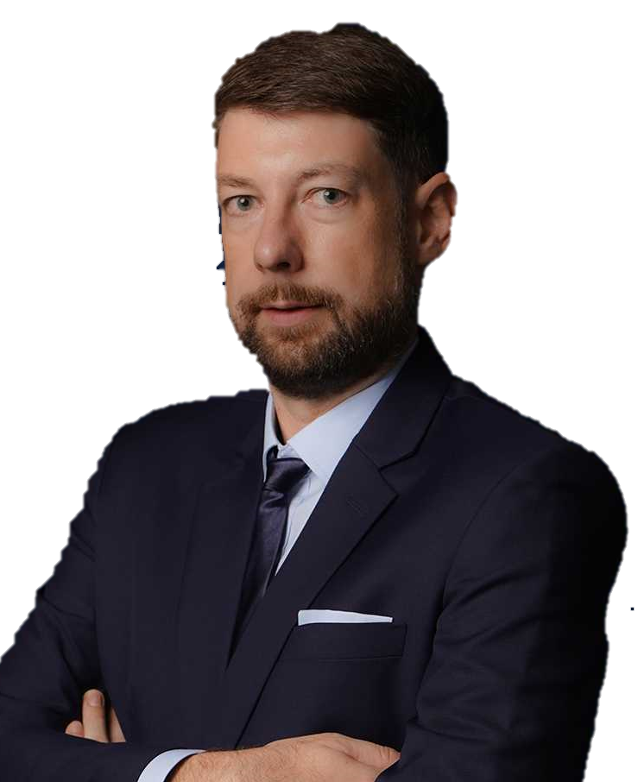
OUR MISSION:
“We keep the world moving, by deploying the best expertise to craft tailor-made solutions that solve the most challenging logistic problems all around the world.”
TORBJÖRN LARISCH
CHIEF EXECUTIVE OFFICER

Slide 3
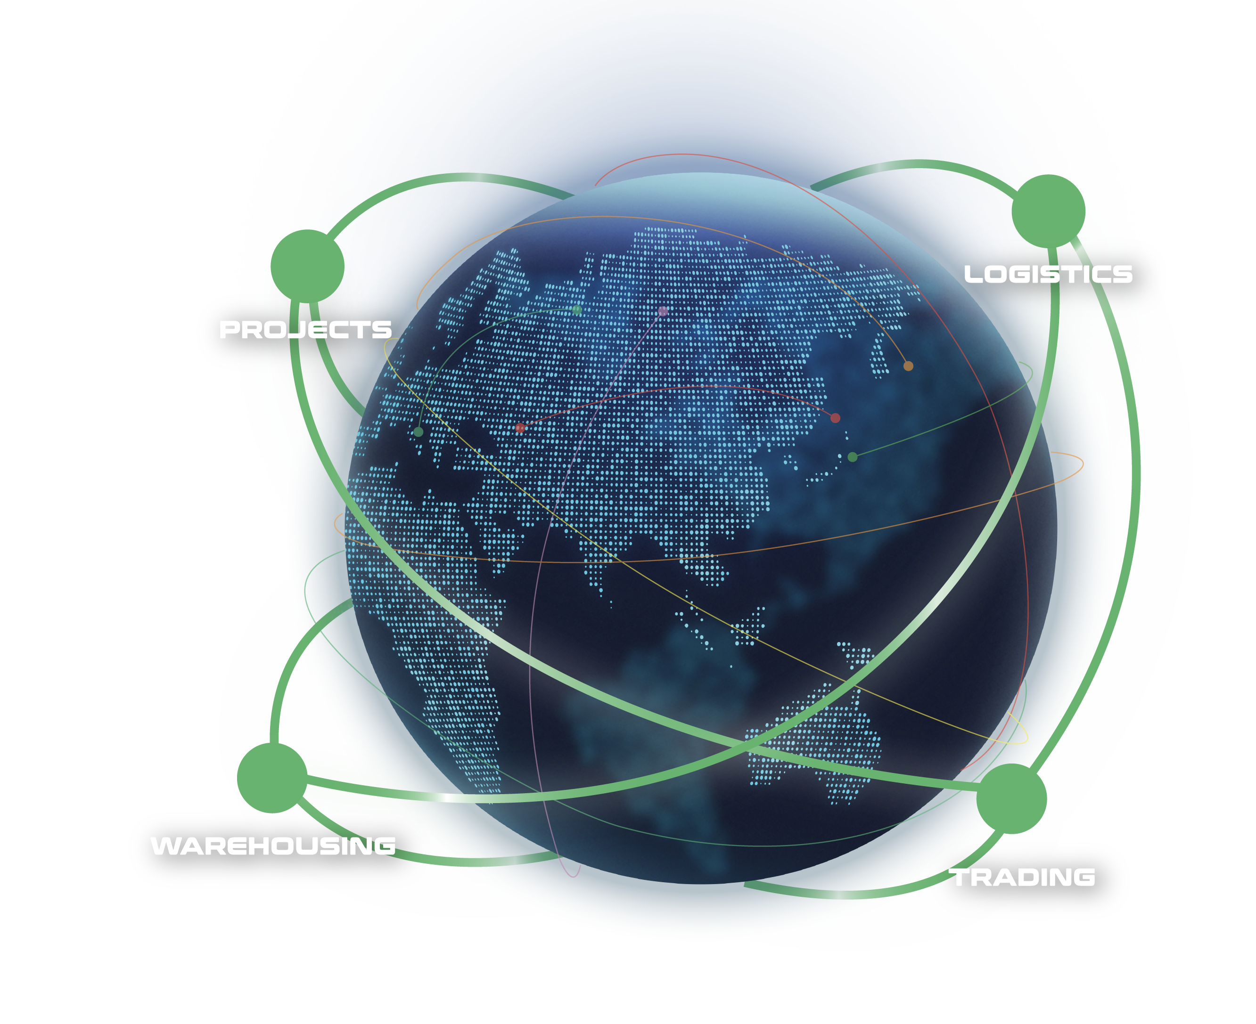
WHAT ARE OUR CAPABILITIES
Our interconnected supply chain solutions are tailor-made to keep your world in business.
OUR VISION:
To be recognized globally as the logistics experts who understand and empower global business leaders to dream and act big; moving the world forward.
PROJECTS: With expert hands, we handle the complicated with precision.
LOGISTICS: We humanize a seemingly standardized experience.
WAREHOUSING: We envision spaces that bring supply chains to the next level.
TRADING: We define and shape solutions to meet ever-changing needs.
3

Slide 4













FLS SNAPSHOT
33+
700+
100+
80+
years of experience
professionals
global partners
owned EV trucks
14
$65 million
40,000+ sqm
countries
largest single contract award
covered space
of warehousing
ANNUALLY
40,000+
10,000+
280,000+ FRT
trucks moved
customs clearance cases
Project Cargo shipped
25,000+
14 million kg
$250 million
TEUs shipped
air freight cargo handled
global revenue

Slide 5
FLS HISTORY
FLS ventured more and more into handling export projects from steel fabricators in Thailand, Korea, China, Vietnam, Malaysia and Indonesia to global destinations for major engineering companies in the Power, Petrochemical and Mining industries.
After almost three decades, we have expanded our services from project cargo into a wider portfolio include:
FLS Logistics
FLS Warehousing
FLS Trading
Neon Orient acquisition
FLS Supply Chain Center establishment
2001 – 2010
2020 – 2023
1993 - 2000
2011 – 2020
NOW
The company was founded in Bangkok in May 1993 by Martin Häberli when he was awarded several major projects in Thailand.
In 2011 FLS (Vietnam) Ltd. was established, followed by
FLS (Australia) Pty Ltd. in 2013
FLS (Singapore) Pte Ltd. in 2014
PT. Federal Logistik Sistem (Indonesia) in 2014
FLS Projects (USA) Inc. in 2016
FLS Projects (Taiwan) Ltd. in 2016
FLS Projects (Malaysia) Sdn. Bhd, in 2018
FLS 1993 (India) Pvt Ltd.
In 2024, we embarked on a new chapter, broadening our global reach with the establishment of
FLS Scandinavia
FLS Norfolk, USA
FLS Group (Japan)
ITL acquisition
FLS Philippines
FLS Italy
5

Slide 6
OUR GLOBAL PRESENCE
USA
Denmark
India
Thailand
Italy
China
Japan
Myanmar
Vietnam
Philippines
Malaysia
Singapore
Australia
FLS Offices
Indonesia
FLS close network partners
6

Slide 7




OUR COMPETENCIES
EXPERIENCED
COMPETIVE
More than 30 years of experience
Global access to carriers, local contract negotiations
FLEXIBLE
INNOVATIVE
Matching right partners for each project
We can solve problems with creative solutions and will adjust our operation to your requirements
PRO-ACTIVENESS
Eyes and ears always on the market and therefore can react to possible constraints early
DYNAMIC
Growth through opportunity, where others see a problem, we see an opportunity
Fast decision-making process
CONTINUITY
High employee retention rate: average is 8.32 years. Some key staff have been with FLS for more than 15 years
7

Slide 8






WE ARE A PROUD MEMBER OF:
8

Slide 9
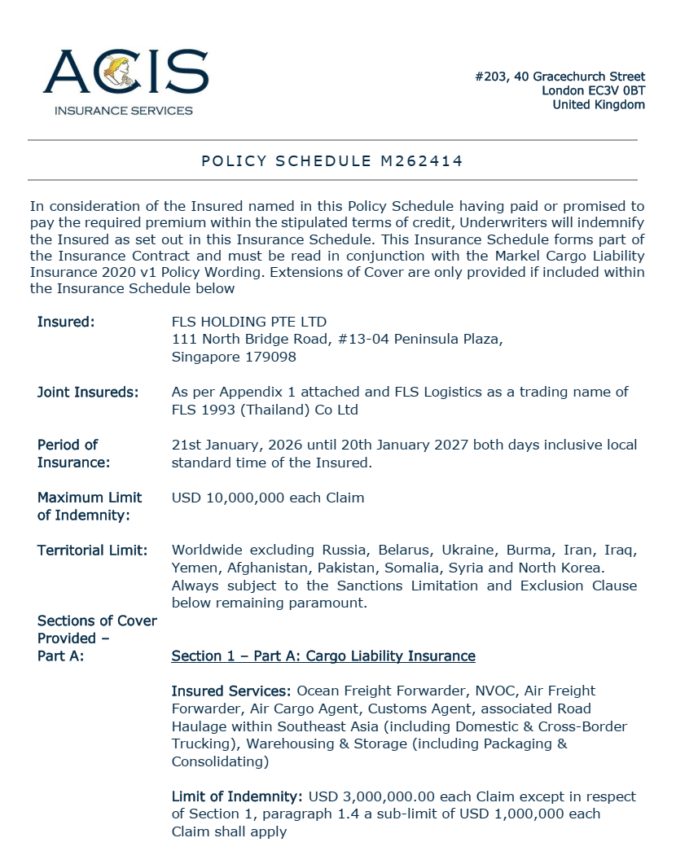
INSURANCE POLICY
Base coverage:
Cargo liability
USD 3,000,000 each claim
3rd party legal liability
USD 3,000,000 each claim
Professional indemnity
USD 400,000 each claim
Fines and duties liability
USD 100,000 each claim
Please note: Limits are flexible & negotiable, and liabilities can be extended on request and a case-by-case basis. Marine cargo insurance can be provided. on request.
9

Slide 10
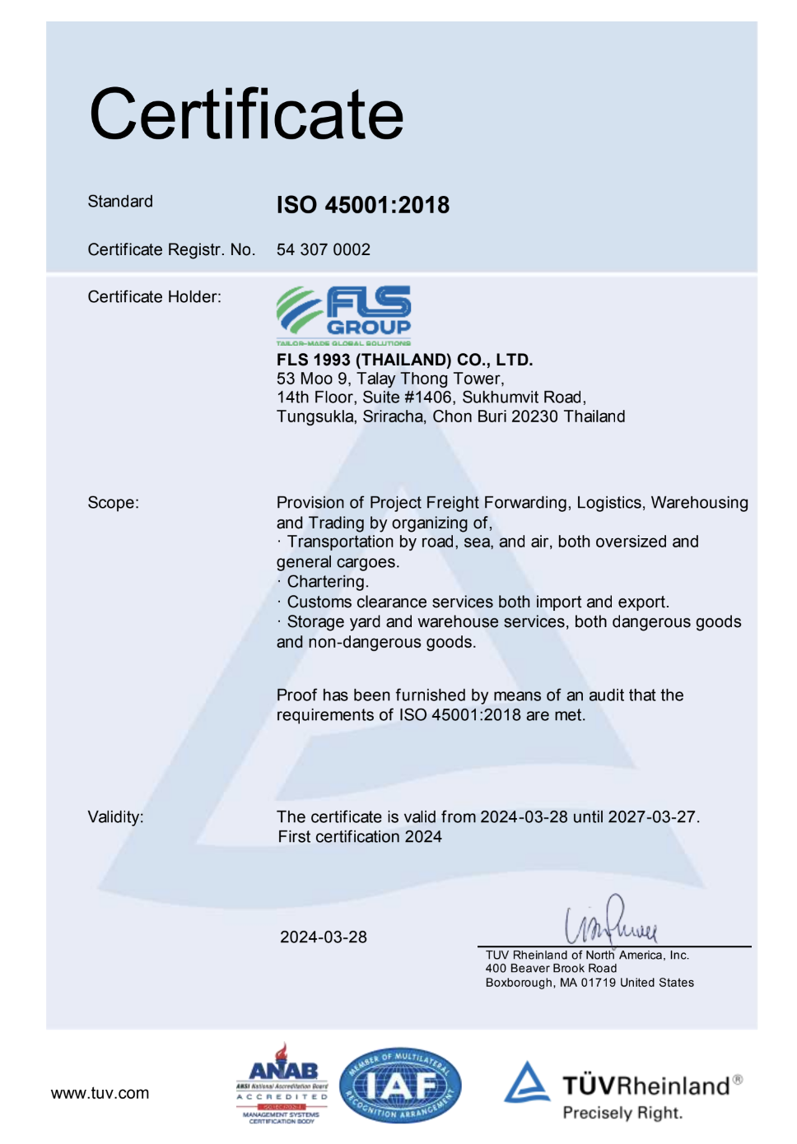
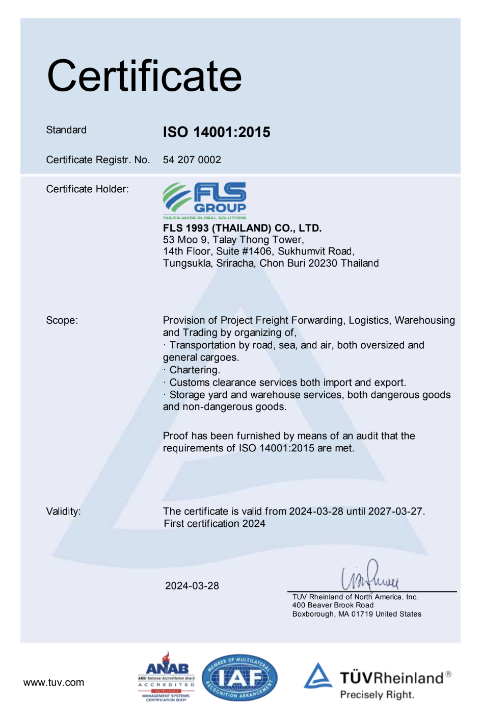
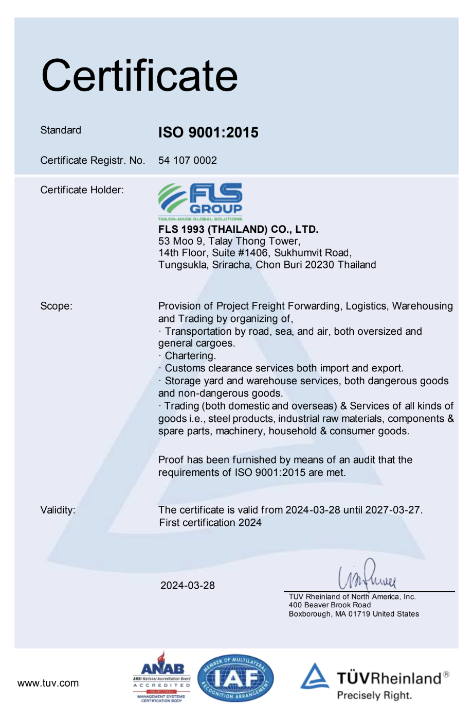
HSEQ Procedures
SAFETY, QUALITY & INTERNATIONAL COMPLIANCE
ISO 45001:2018 CERTIFICATE
ISO 4001:2015 CERTIFICATE
ISO 9001:2015 CERTIFICATE
ISO-certified own operations in Thailand, Australia, Singapore, USA, Vietnam, Taiwan, Indonesia, Malaysia, India and Myanmar.
10

Slide 11


SAFETY, QUALITY
& INTERNATIONAL COMPLIANCE
QUALITY ASSURANCE
HEALTH & SAFETY
OUR STANDARDS
FLS Quality Management Systems meet all our customer’s applicable statutory and regulatory requirements.
We use one of the world’s leading modular enterprise systems to streamline operations, accounting and business development.
Provide Health & Safety training for all members of staff as well as blue-collar and sub-contracting parties.
Follow international rules and guidelines to foster a safe and healthy working environment for our teams.
Ensure that each project and every shipment is handled in a safe, timely, systematic, and efficient manner.
We select and work only with agents and partners who:
are fully certified to international standards
fulfill our own strict quality standards
have sufficient insurance coverage
operate with well-maintained and regularly tested equipment
are well managed and staff regularly trained
have a long successful history and proven track record.
11

Slide 12

OCCUPATIONAL HEALTH, SAFETY
AND ENVIRONMENTAL POLICY
FLS requires the active commitment to, and accountability for, occupational health, safety and environment from all employees and contractors.
Comply with all relevant legislations and corporate requirements of OHSE;
Meet specified customer requirements and ensure continuous customer satisfaction;
Protect, and strive for improvement of, the health, safety and security of our people at all time;
Eliminate accidents and minimize potential risks;
Set OHSE performance objectives, measure results, assess and continuously improve processes and services, through the use of an effective management system;
Plan for, respond to and recover from any emergency, crisis and business disruption;
Minimize our impact on the environment through pollution prevention, reduction of natural resource consumption and emissions, and the reduction and recycling of waste;
Apply our technical skills to all OHSE aspects in the design and engineering of our services;
Communicate openly with stakeholders and ensure an understanding of our OHSE policies, standards, programs and performance. Reward outstanding OHSE performance;
Improve our performance on issues relevant to our stakeholders that are global concern and on which we can have an impact and share with them our knowledge of successful OHSE programs and initiatives.
12

Slide 13

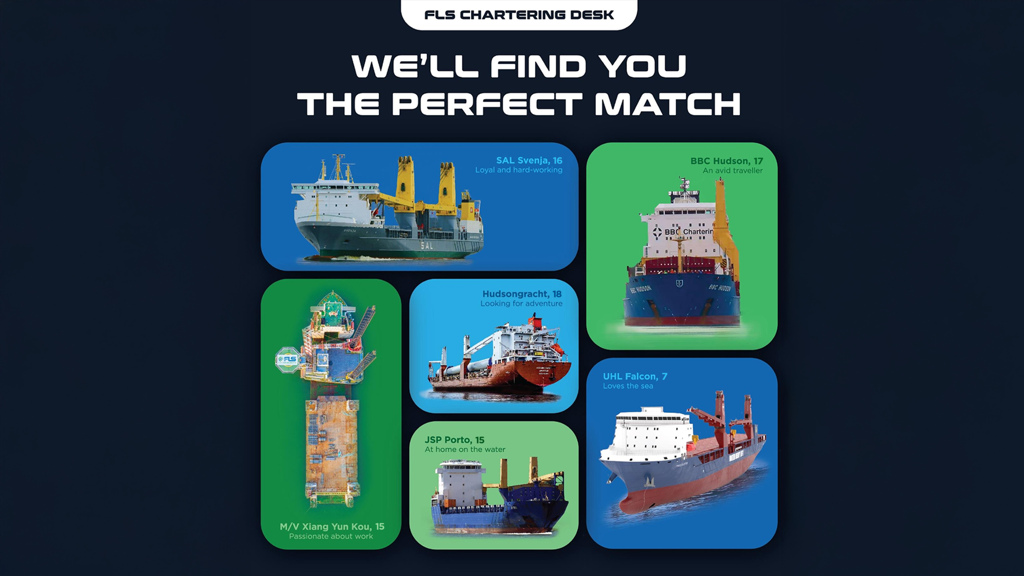

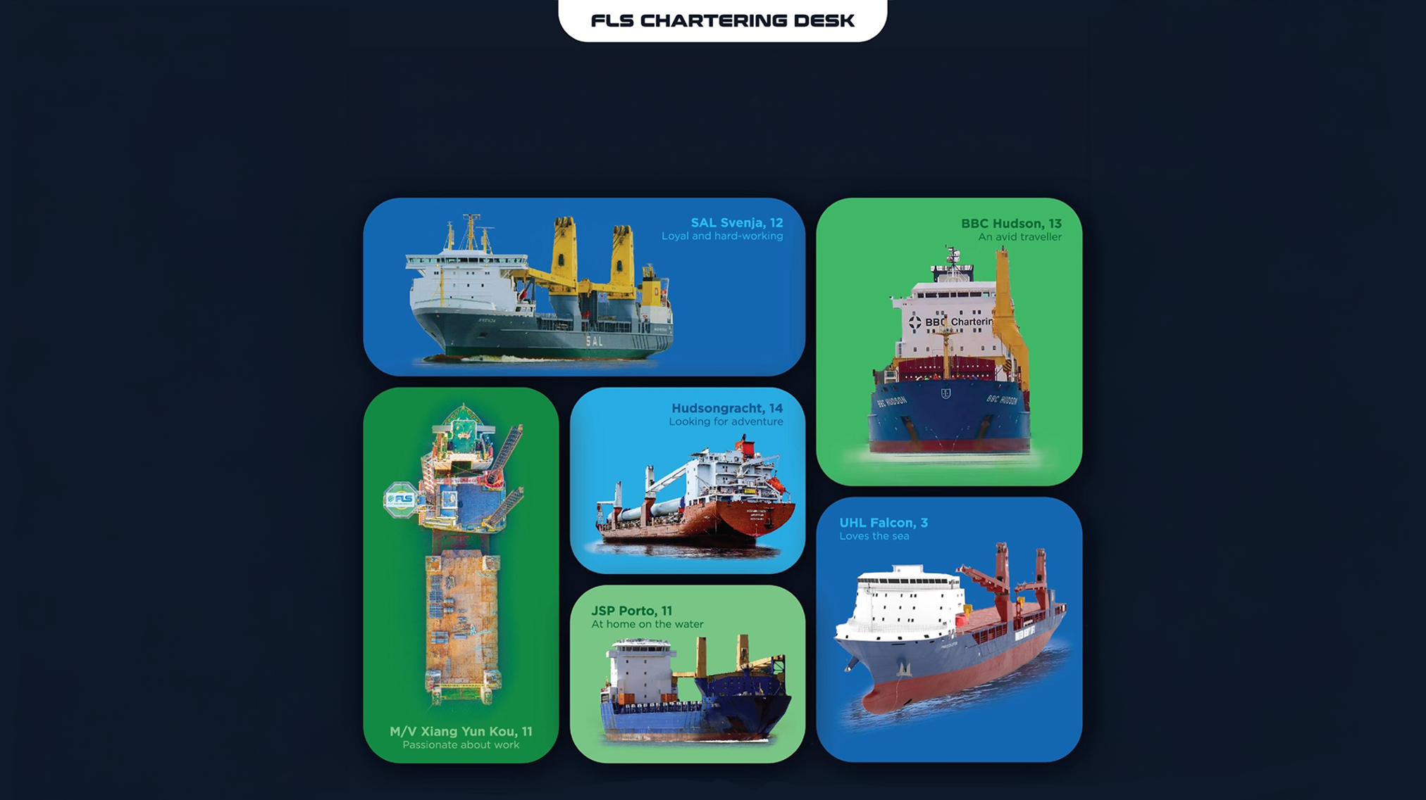
WE’LL FIND YOU
THE PERFECT MATCH

Slide 14
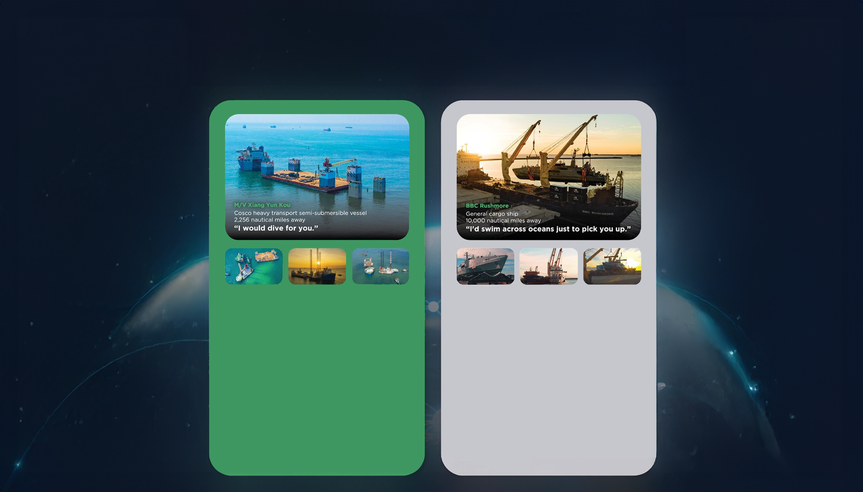
THE RIGHT VESSEL AT THE
RIGHT PRICE AT THE RIGHT TIME
• Half swimmer, half diver
• The big lady of the sea
• Nothing is too big to handle
• Matched with: a 7.000 tonne-floatina drudock and a 6.000-tonne liftboat.
Our buying power and creative solution of combining two shipments allowed us to lock in thebest pricing and the fastest shipping time, despite an extremelv short notice period.
The float-on, float-off loading operation went smoothly and the threesome enioyed a safe journey from Vietnam to Malavsia and the Philippines.
• Any port. Any cargo.
• Accommodating and spacious
• Sailing under the name of the global market
leader of ocean
• Matched with: Austal-built coast guard vessels
As these state-of-the-art vessels are crucial assets for the Trinidad and Tobago coast guard, a best-in-class, door-to-door delivery solution was needed. After securing the reputable BBC Rushmore for these vessels.
FLS experts designed special shipping cradles to support and protect the mono aluminum hulls during the lifting operation and arranged professional divers for a precise loading operation

Slide 15
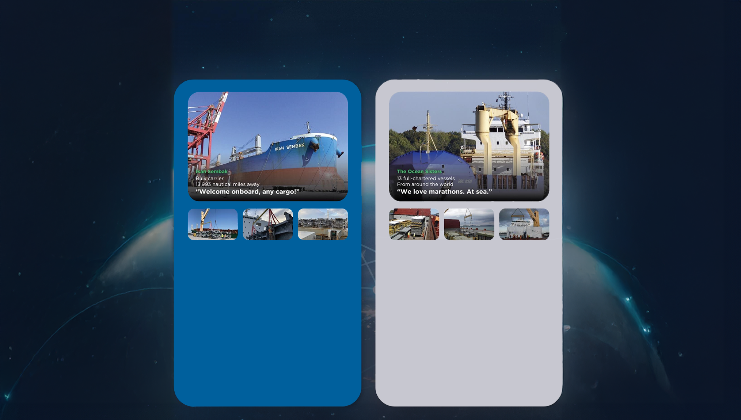
At FLS Chartering Desk we pride ourselves on having long-standing relationships with vessel owners all around the world. This means we can find the perfect match for your needs, while also trying to fulfill your budget and time requirements.
Below are just a few of the perfect matches we've made for our customers.
• Born in Japan
• Enjoying fantastic voyages for the last decade
• Making friends across the globe
• Matched with: Niles, Guernsey and Jackson
combined-cvcle power plants.
Six successful voyages matched so far! FLS
provided packaging guidance and improvement, with customised metal frames to protect the stability of the heavy cargos and our in house stevedores assisted various lifting and lashing operations.
We successfullv saved costs and reduced transit time for two clients in this consolidated shipment.
• We go where cargos love to be
• Devoted to you
• Teamwork is dreamwork
• Matched with: 164 modules, around 225.000
FRT of equipment for a petrochemical plant
in Houston, USA.
A complicated multimodal project which took us 1,5 years to complete. As well as 13 full-chartered vessels, we also provided bespoke trucking, wrapping, stowage and barging solutions.
Our good relationship with carriers and local authorities helped the cargo enjoy a comfortable journey.

Slide 16
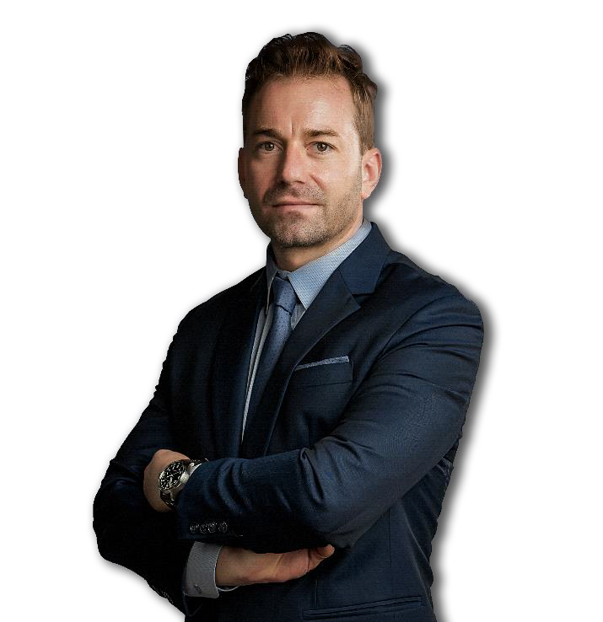
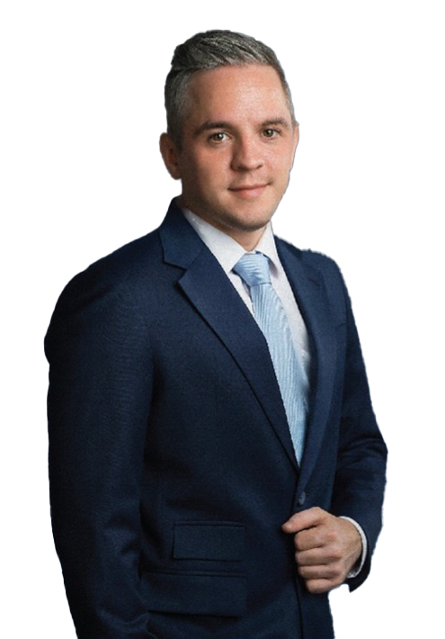
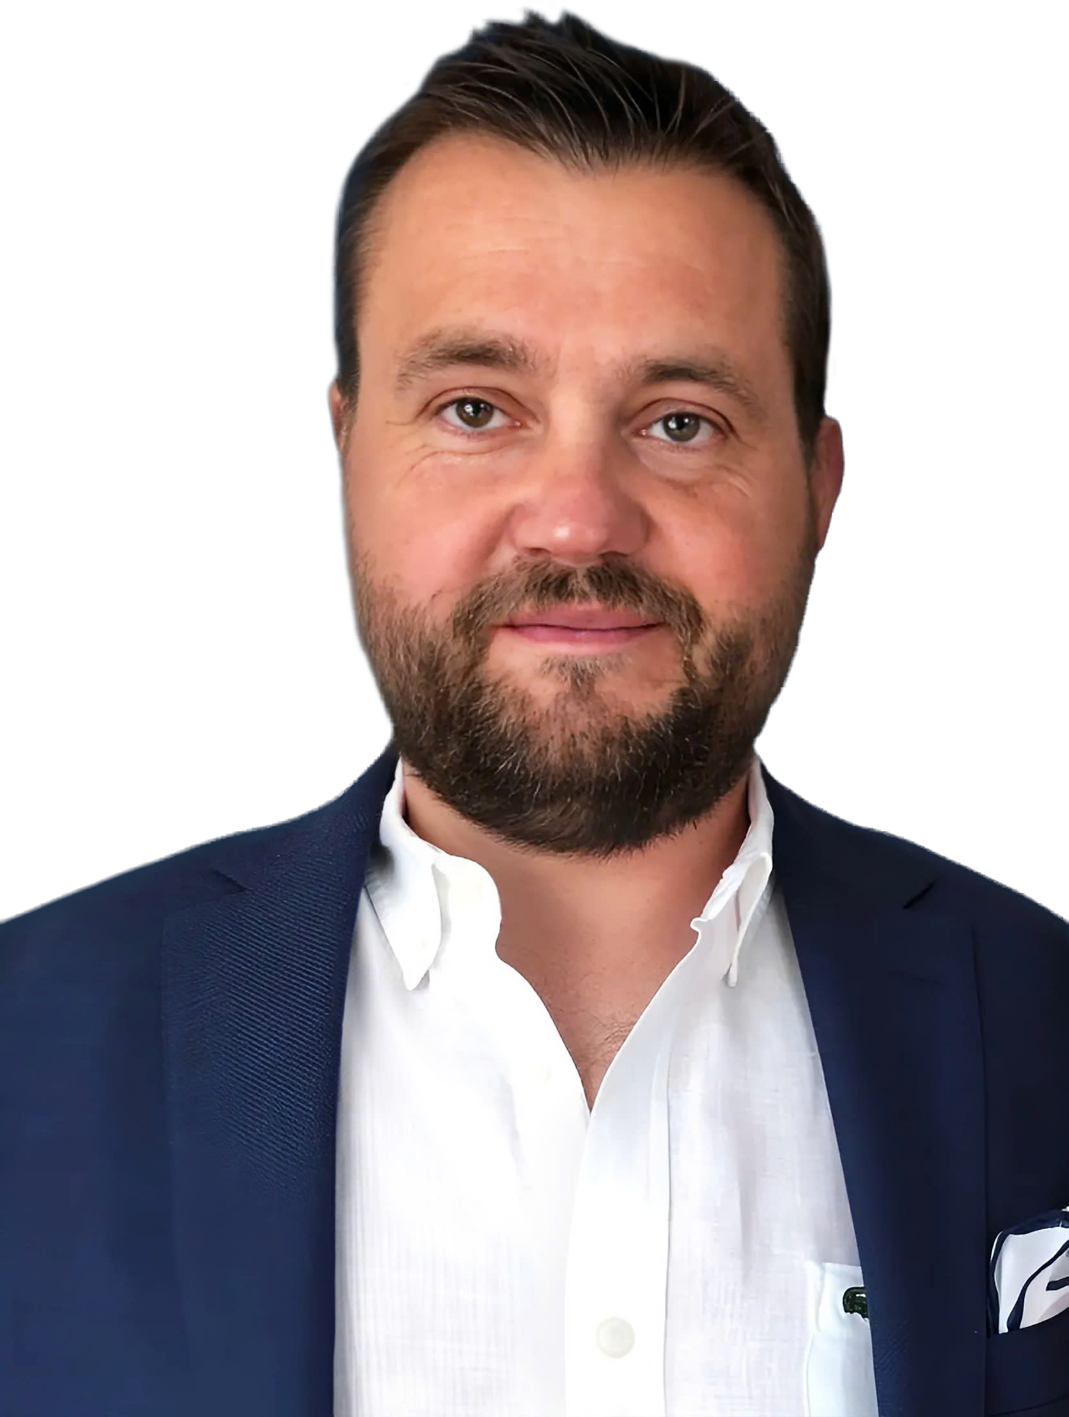
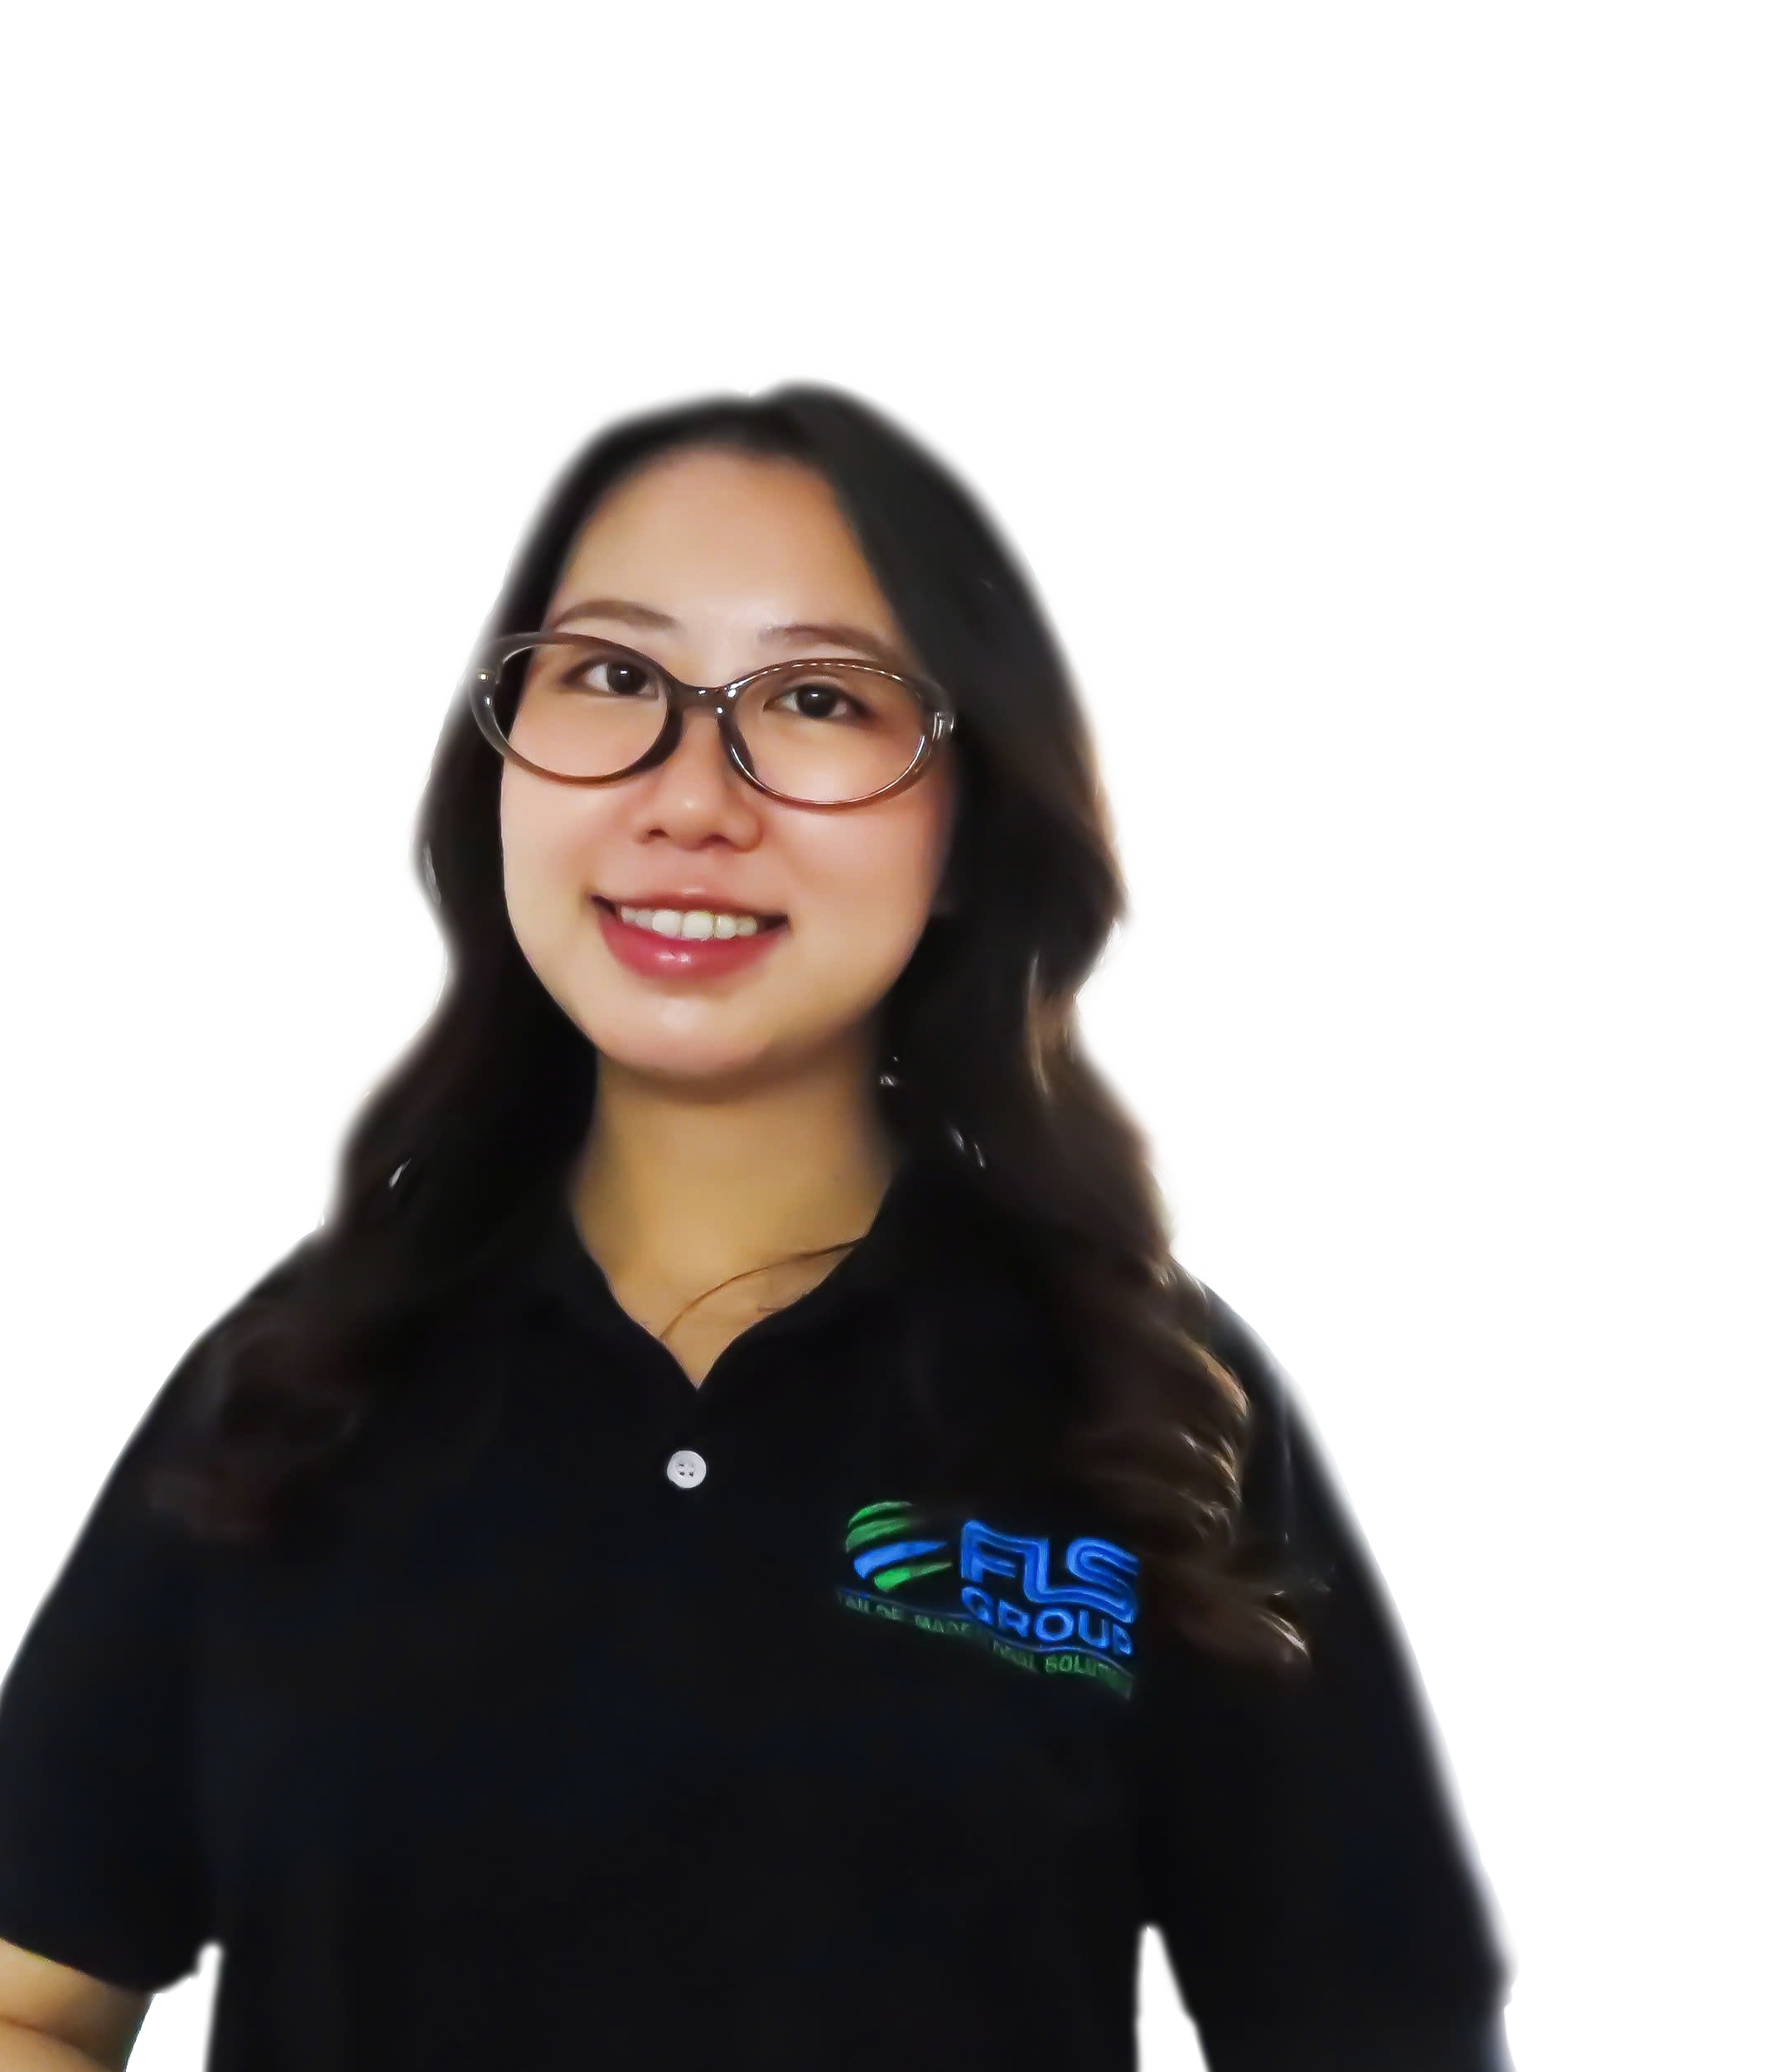
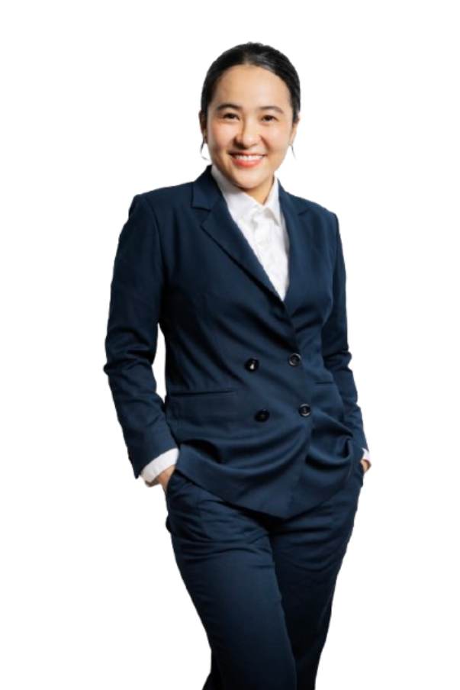
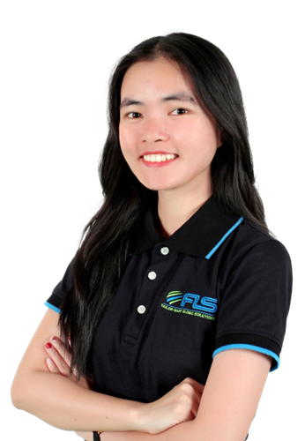
GLOBAL VESSEL ACCESS. PRECISION OPTIMIZATION
FLS Chartering Desk provides direct access to a global network of vessel owners, enabling unrestricted selection across the market. Leveraging strong buying power and deep market understanding, we optimise every charter for cost, timing and operational performance.
CHRISTOPHER SCHNIEDERS
GLOBAL DIRECTOR PROJECTS
SVEN
HOEHLE
HEAD OF GLOBAL PROJECT SOLUTIONS
SUNE
THORLEIFSSON
MANAGING PARTNER | CHARTERING
VI
NGUYEN
CHARTERING
MANAGER
KHUONG
NGUYEN
PROJECT SOLUTIONS
EXECUTIVE
LINH
NGUYEN
CHARTERING
EXECUTIVE

Slide 17
FLS Group Chartering Desk
Purpose of the chartering desk
1 | Centralize market insight, customers benefit from up-to-date insights on freight rates, bunker prices, and carrier performance, conditions, often securing better deals than if the customer approached shipowners directly
2 | Legal and limit commercial risk, direct oversight ensures that all transport activities comply with regulations, reducing the risk of legal issues, ensuring smooth operations and protecting customer interests
3 | Get unfiltered first-hand information in order to make quick and qualified decisions (in case of delays in production, on the job-site etc.). Greater visibility into supply chain.
4 | Provide technical input and increased usage of inhouse engineer to add value. Transport plan will be tailor-made to your needs.
17

Slide 18
Case studies

Slide 19
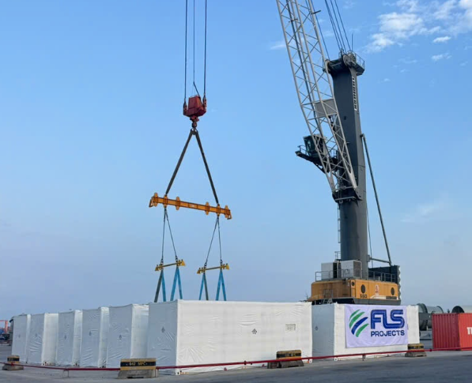
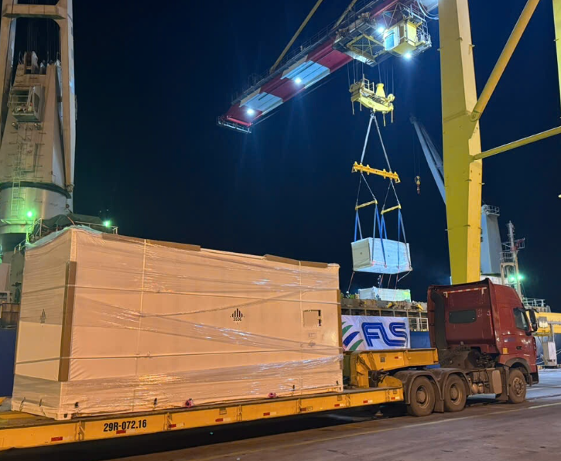
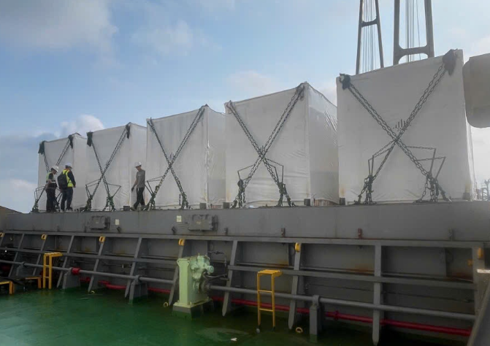
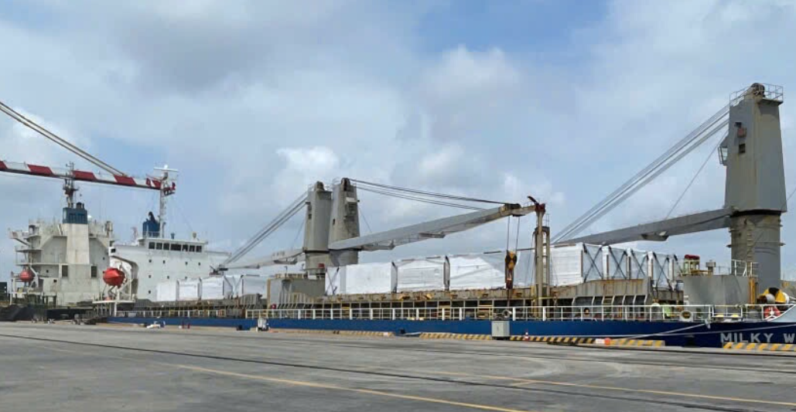
PROJECT REFERENCES
PROJECT REFERENCES
CASE STUDY – BESS VENTOLINES PROJECT
Project Name: BESS ventolines Project
Client: Fluence Energy ,LLC
Volume: Appr. 2,219 FRT break bulk, 46 units
Heaviest 46.28mt
Commodity: BESS units CATL 306 and CATL530
Origin: Hai Phong, Viet Nam
Destination: Rotterdam ,Netherland
Scope:
Quality of work and safety sequences HSE
Chattering multipurpose vessel
Loading BESS units on bed trailers from storage
Trucking cargo along side ship
STS crane loading BESS units on decks
Securing and lashing cargo proper for ocean freight
FLS supervisors on site for survey and consultation work
Co-ordination with ship crews , port authority during operation
19

Slide 20
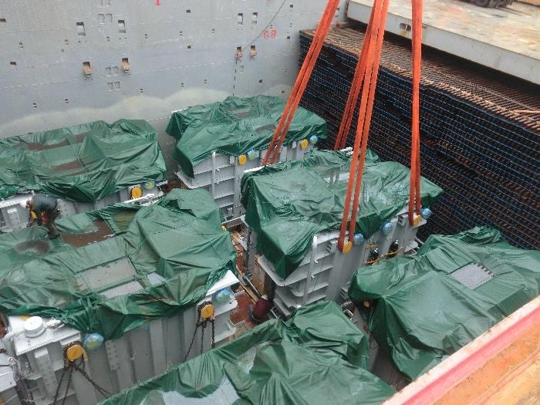
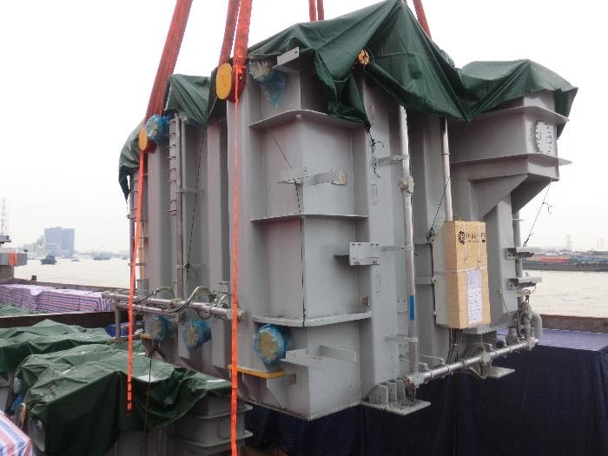
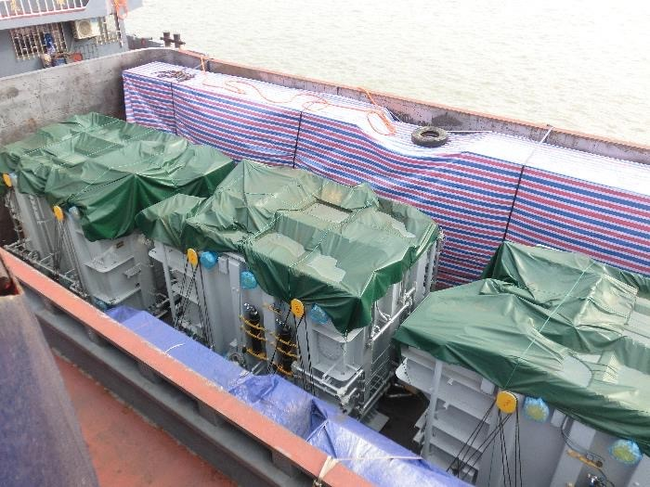
PROJECT REFERENCES
PROJECT REFERENCES
CASE STUDY – TRANSFORMERS #1
Volume: 4,000 CBM
Commodity: Transformers and accessories (max weight 143mt)
Origin: Shanghai, China
Destination: Laem Chabang, Thailand for destination in Laos
Year: 2018
Scope:
Chartering of suitable vessel for ocean transportation
FLS Supervision at loading and discharge port
Liasing with all related parties for smooth operations
Delivery to destination in Laos site
Permit for delivery in Thailand and Laos
20

Slide 21
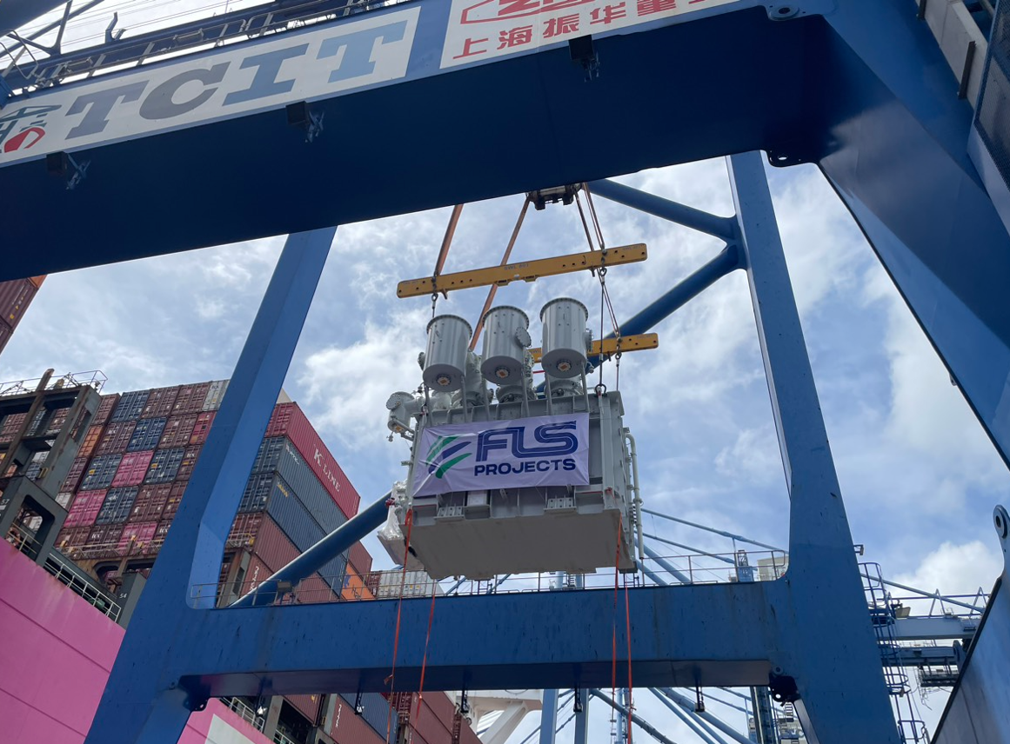
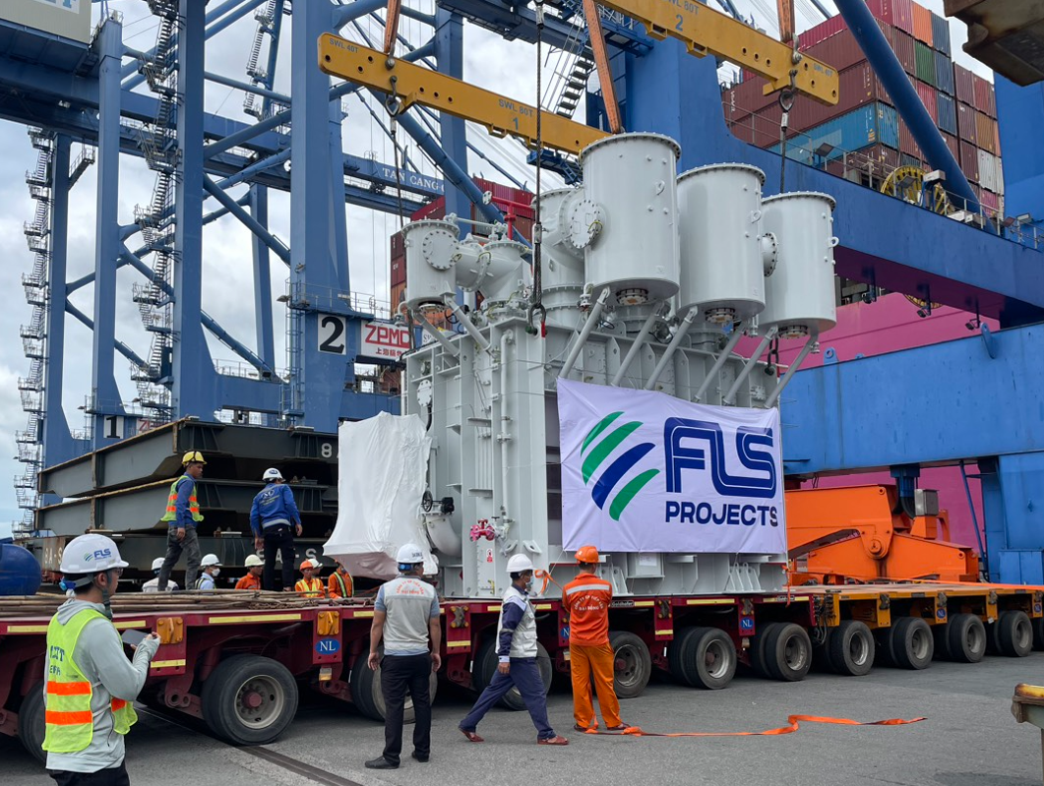
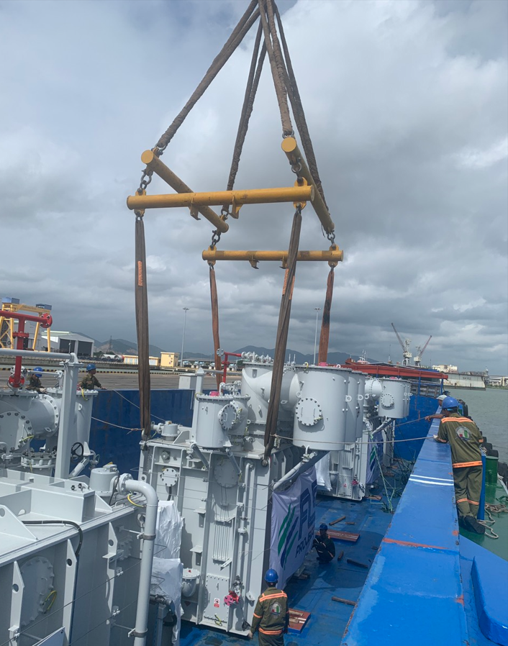
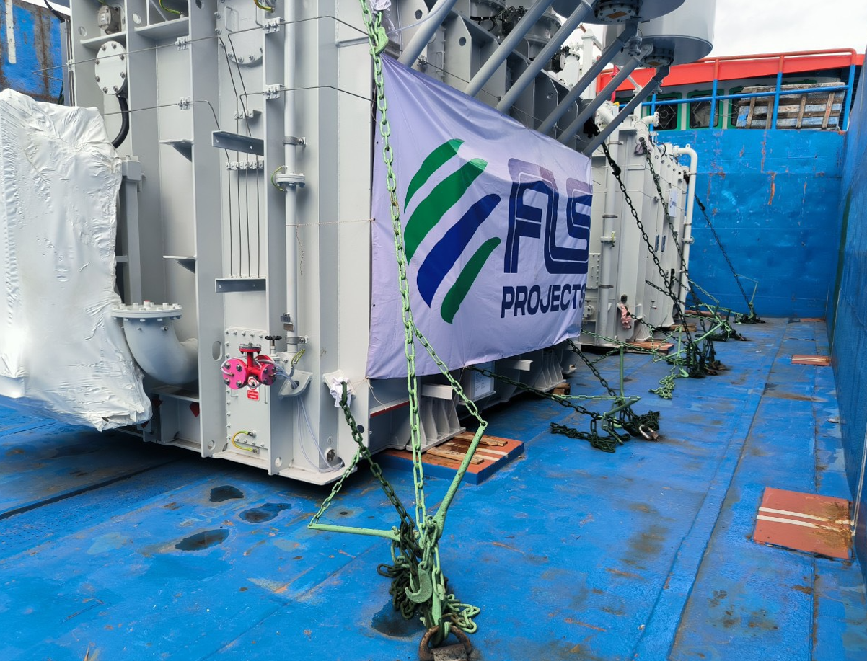
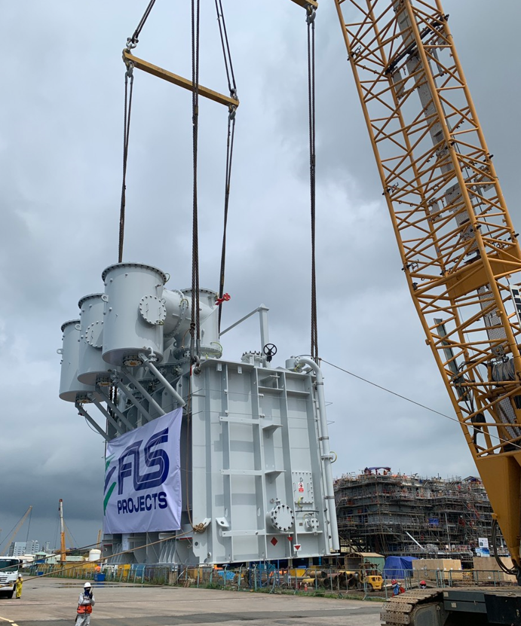
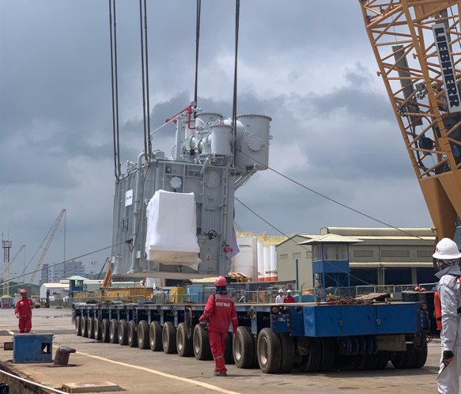
PROJECT REFERENCES
PROJECT REFERENCES
CASE STUDY – 4x transformer 69.1 tONS per each hai long PROJECT
Commodity: 4X 6.12x 4.37x5.16m , 69.1tons per each
Origin: Rotterdam , Netherland
Destination: PTSC port, Vietnam
Scope:
To receive cargo from container vessel at Container port
Load cargo on truck with trailer
Trucking to Bason port ready for load on barge
Barging to PTSC port facility
Loading onto trucks and barge incl appropriate cargo stow arrangements. Cargo hold preparation for loading, layout dunnage by FLS own stevedores
Lashing and secure proper for operation
Loading supervision by FLS Port Captain
21

Slide 22
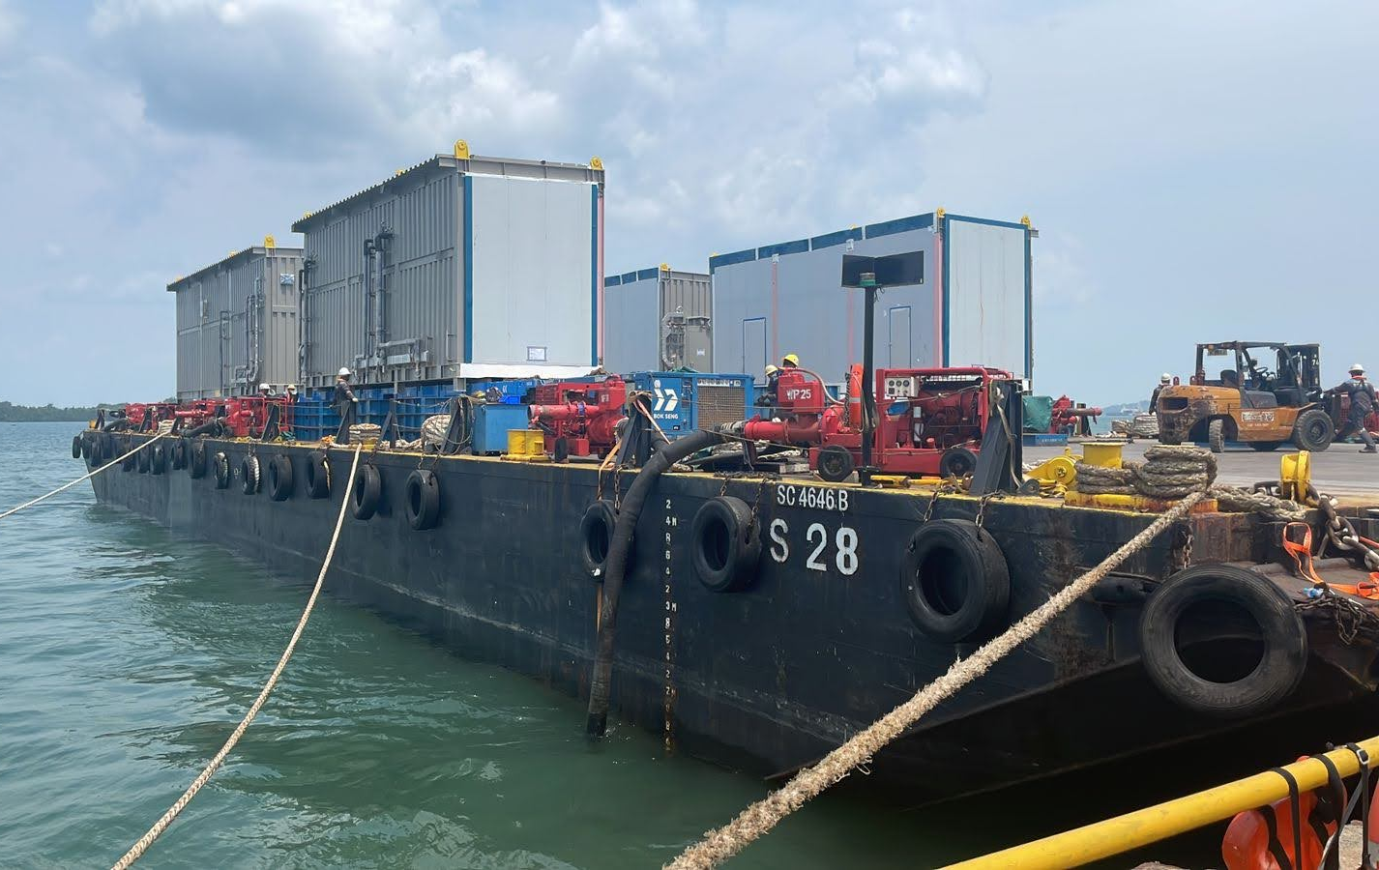
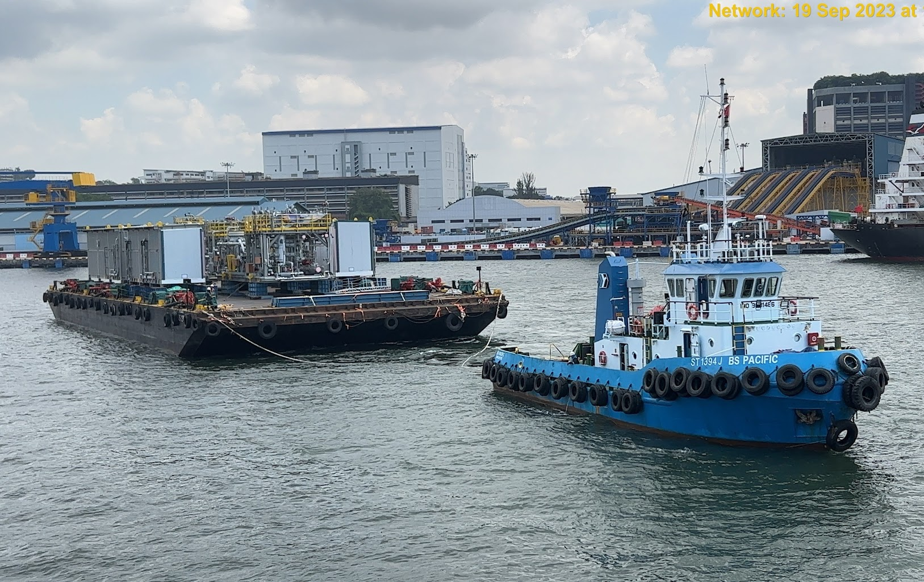
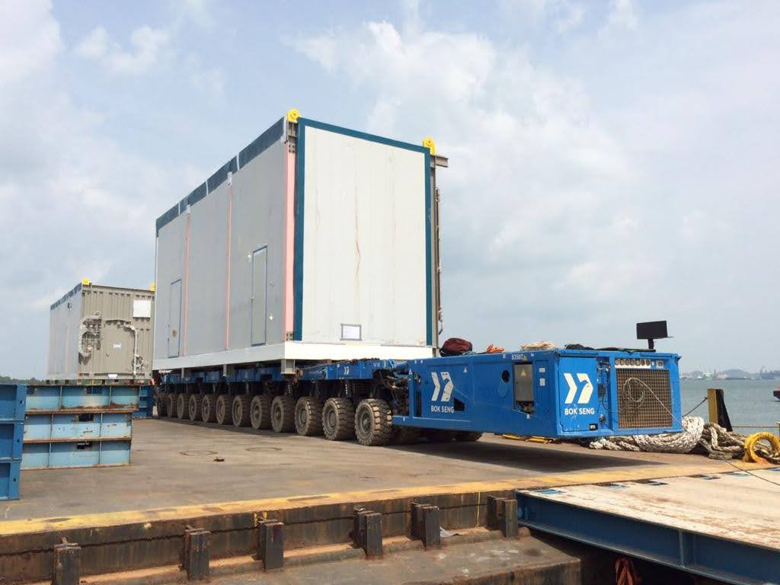
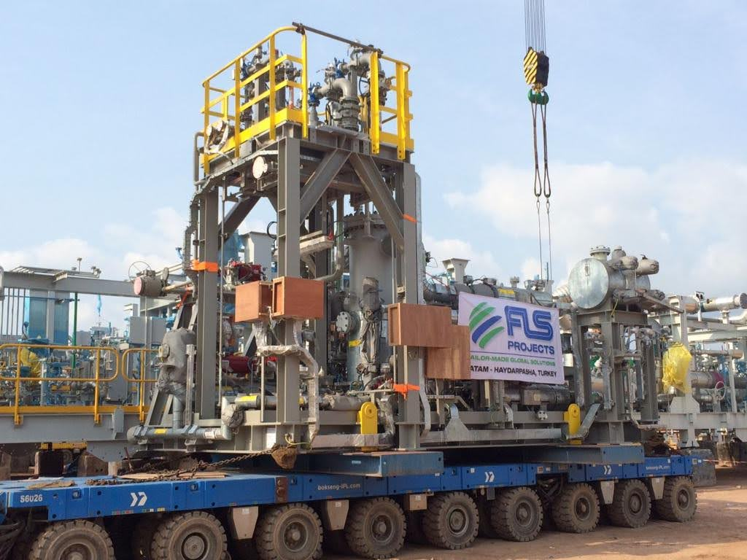
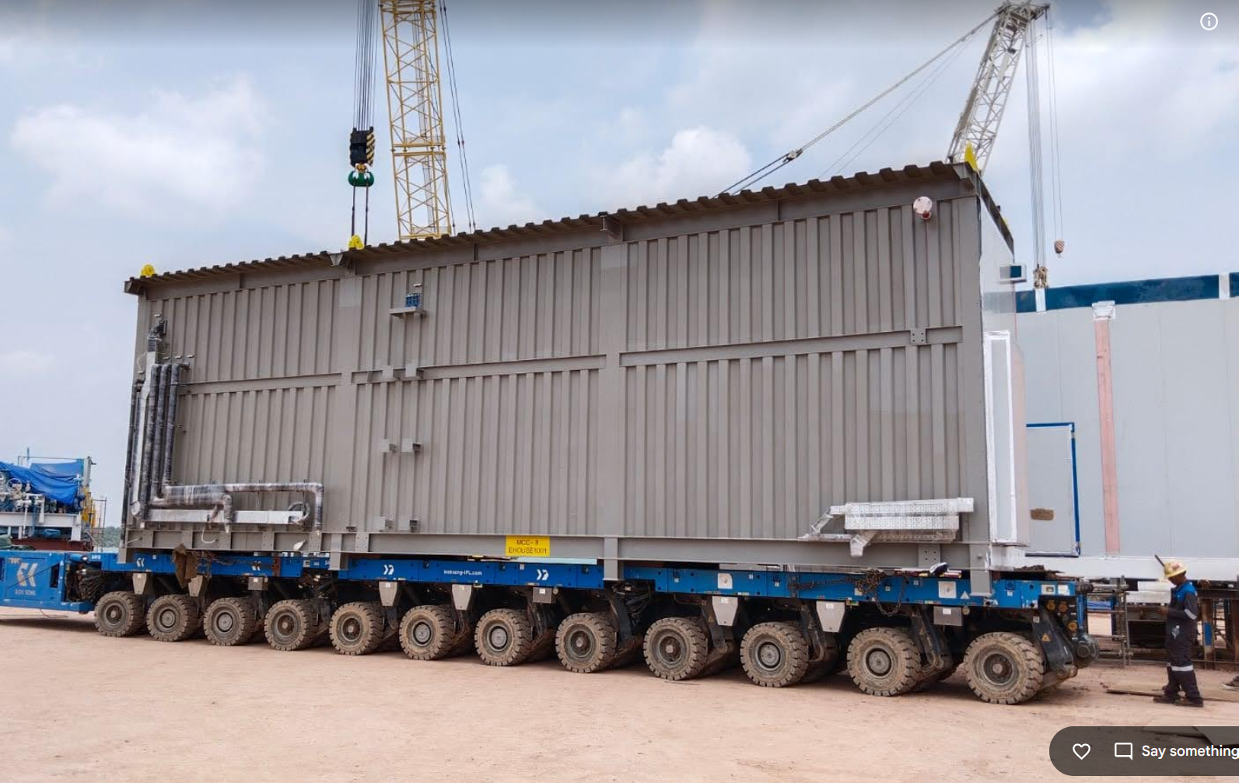
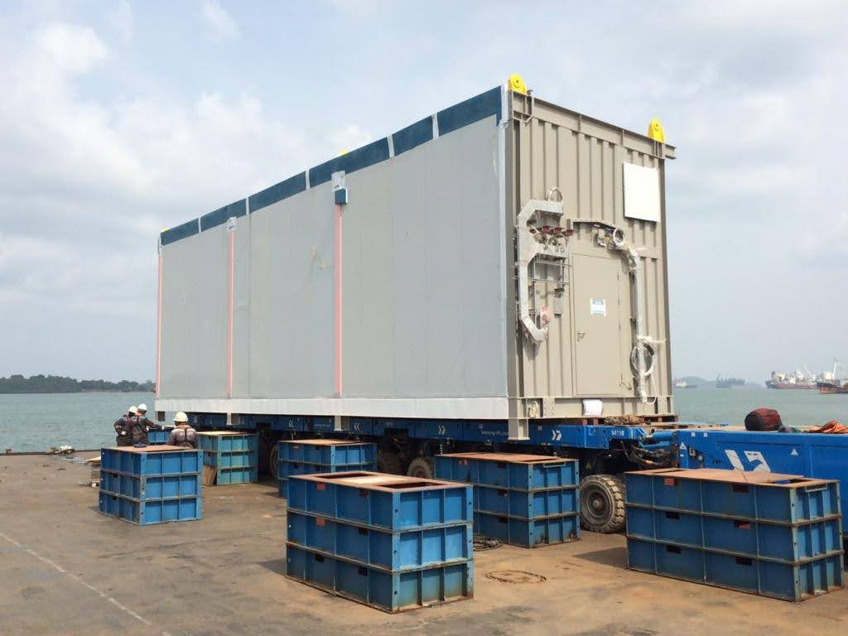
PROJECT REFERENCES
CASE STUDY – Roll-on / Roll-off and Barging of Modules/Sea Freight
Project Name: PROJECT DP3 COMPRESSION PACKAGE
Cargo: Compressor Modules and E-houses
Volume: 43 packages / 566,423 kgs / 3,824.08CBM
Heaviest 138Mt (MAIN INLET COMPRESSOR)
Origin: WASCO, Batam
Destination: Jurong, Singapore
Consignee: Total
Scope:
RORO ex Wasco Batam Jetty onto barge for the OOG items (Bok Seng’s Barge)
LOLO ex Wasco Batam Jetty onto barge for other smaller items (Infiniti’s Barge)
Freight from Batam to Singapore, Jurong port
Overside loading in Jurong port

Slide 23
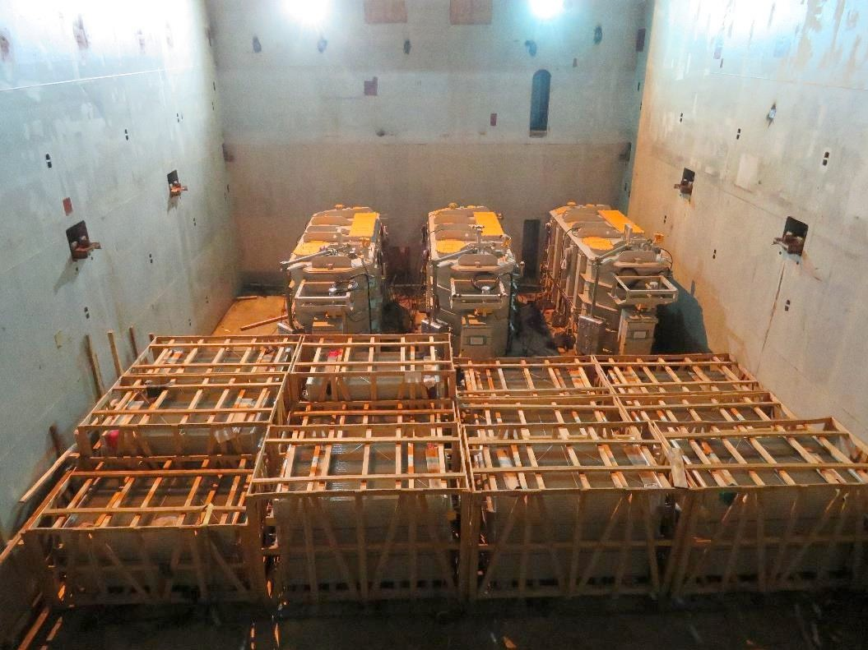
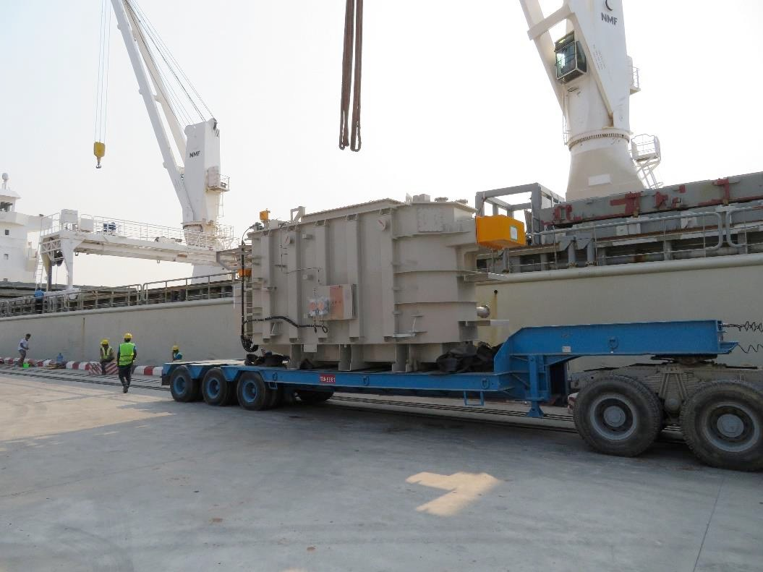
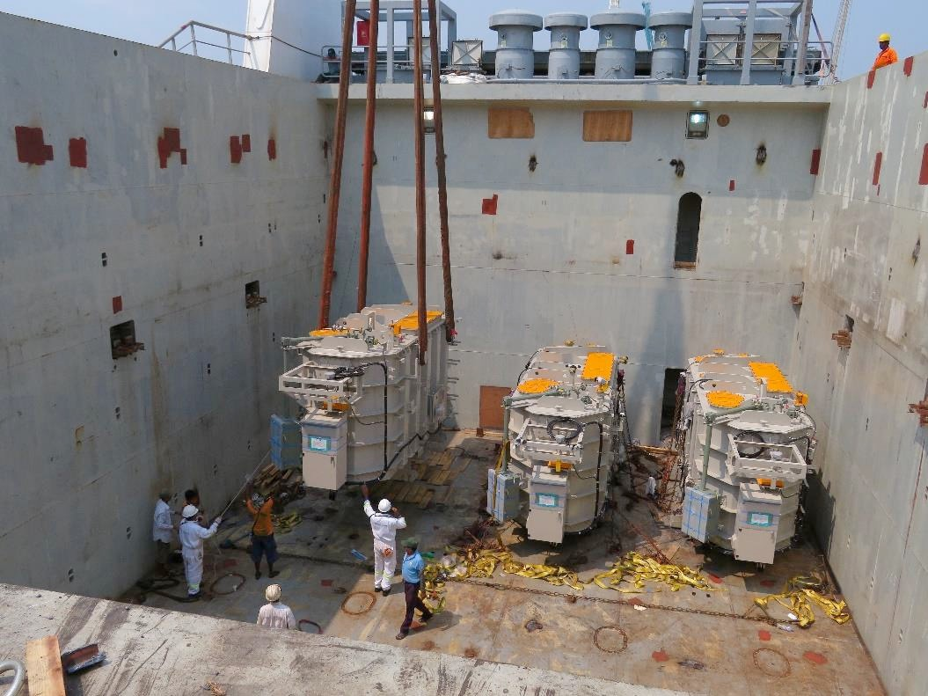
PROJECT REFERENCES
PROJECT REFERENCES
CASE STUDY – TRANSFORMERS #2
Volume: 505.4 CBM
Commodity: 3 Units of transformers and accessories (max weight 44mt)
Origin: Yokohama, Japan
Destination: Yangon, Myanmar
Year: 2018
Scope:
Chartering of suitable vessel for the cargo
Supervision at loading and discharge port
Liasing with all related parties for smooth operations
23

Slide 24
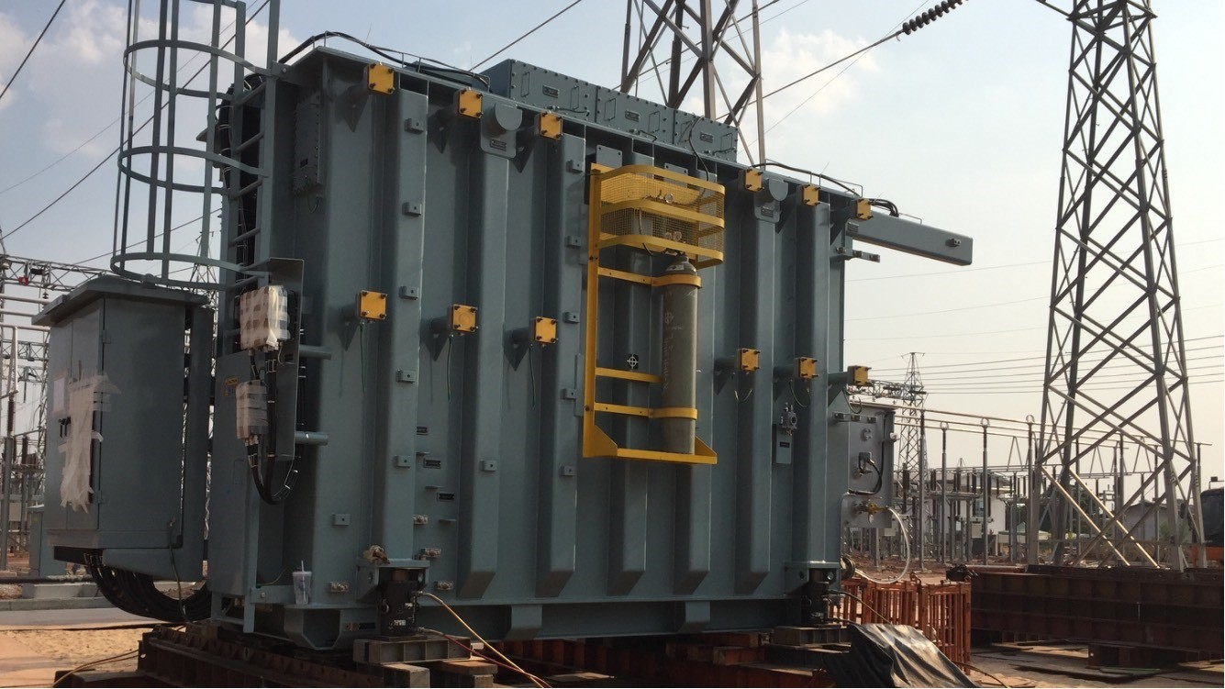
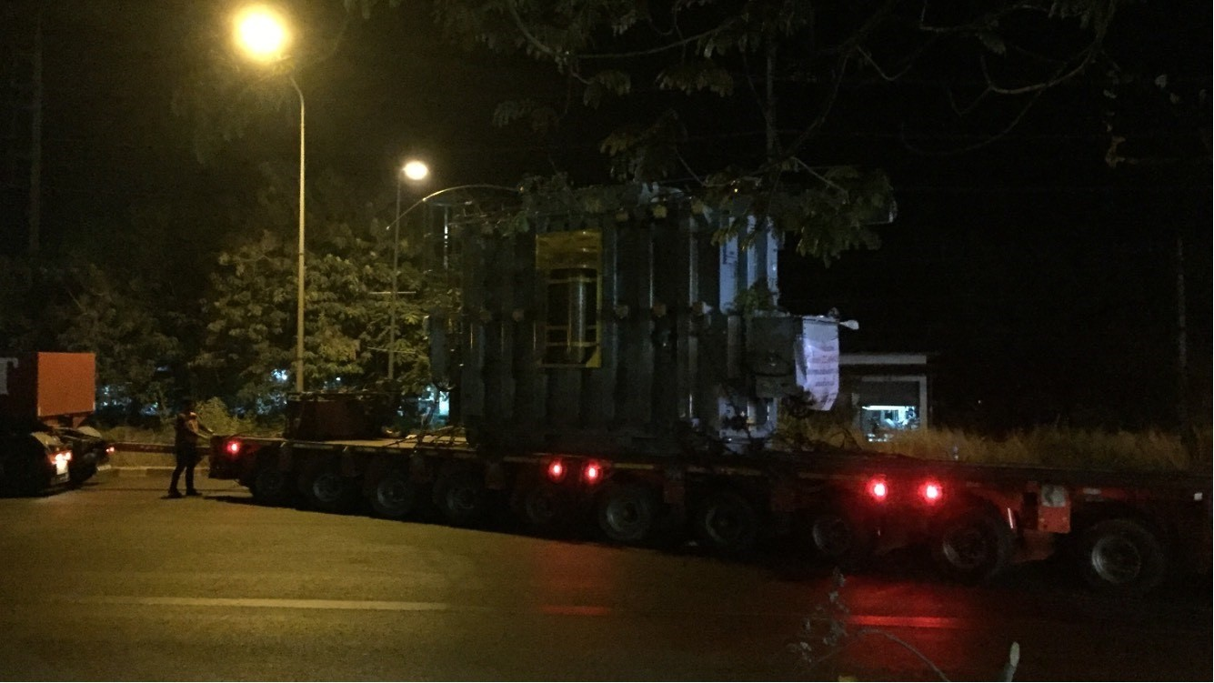
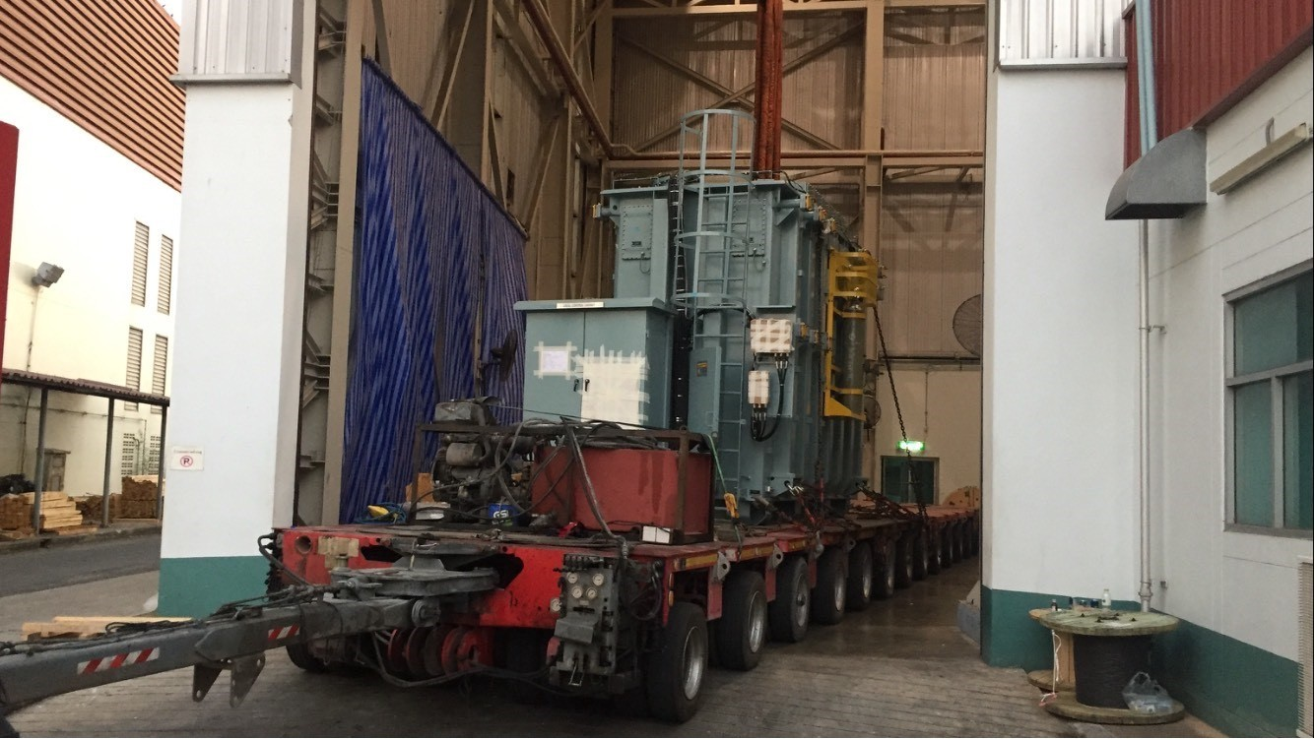
PROJECT REFERENCES
PROJECT REFERENCES
CASE STUDY – TRANSFORMERS #3
Commodity: Transformers and accessories (max weight 67mt)
Origin: Thai Trafo
Destination: Buriram, Thailand
Year: 2019
Scope:
Trucking
Transportation plan and DOH permit
Jacking and skidding at site
24

Slide 25
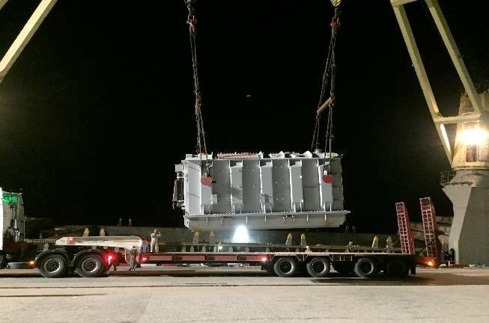
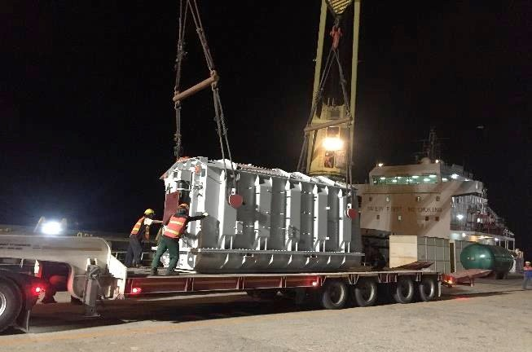
PROJECT REFERENCES
PROJECT REFERENCES
CASE STUDY – TRANSFORMERS #4
Volume: 250 CBM
Commodity: Transformers and accessories (max weight 44.1 MT)
Origin: Shanghai, China
Destination: Laem Chabang, Thailand for destination in Cambodia
Year: 2019
Scope:
Supervision at discharge port
Receiving cargo alongside vessel
Liasing with all related parties for smooth operations
Delivery to destination in Cambodia site by truck
Permit for delivery in Thailand and Cambodia
Jacking and Skidding transformer to foundation
25

Slide 26
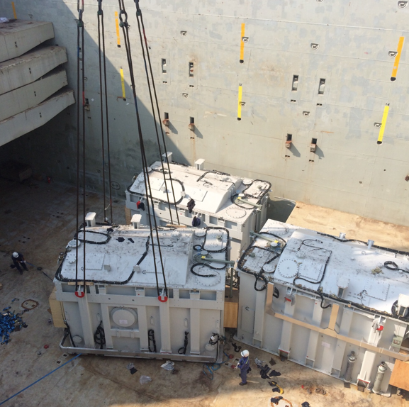
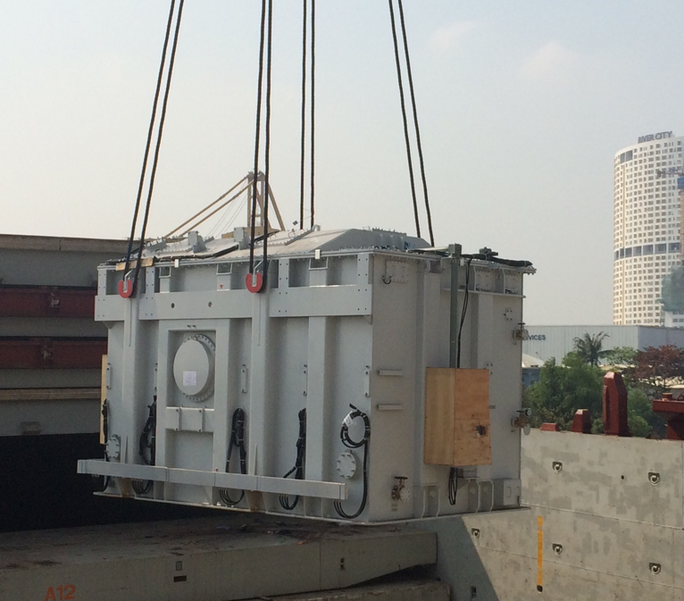
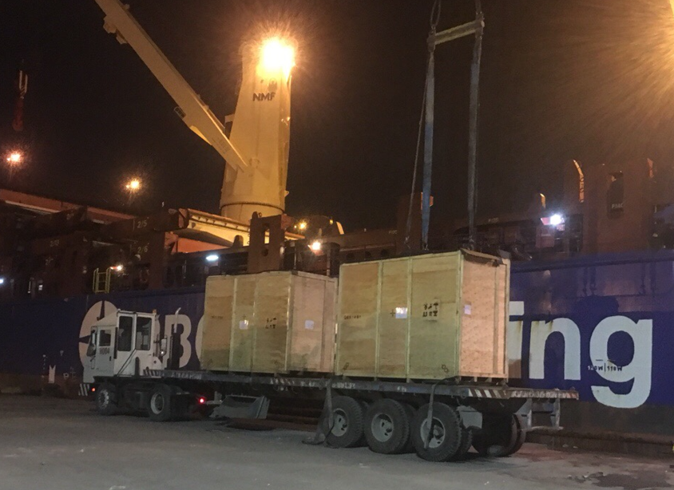
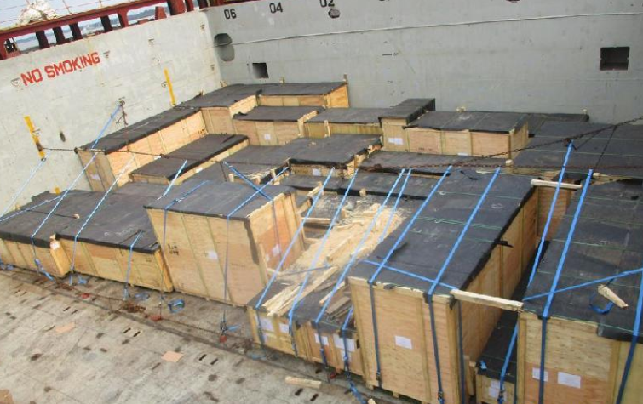
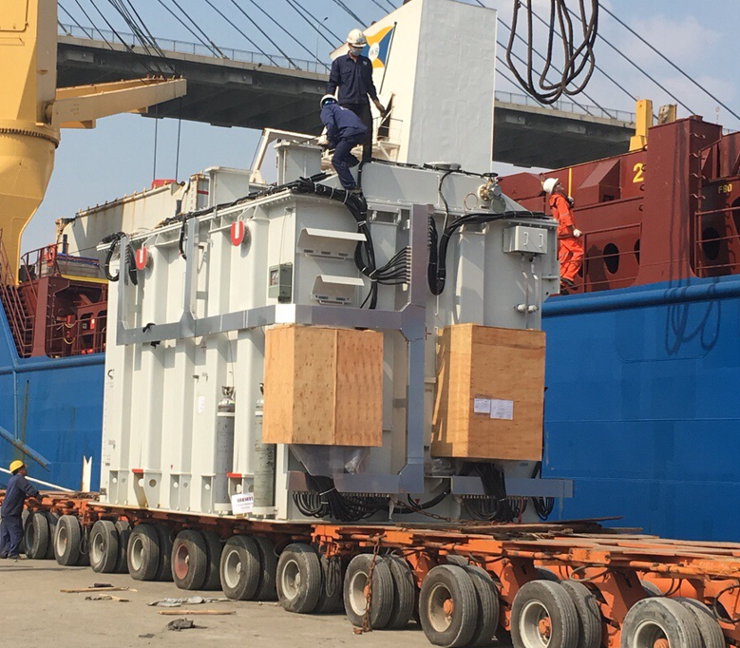
PROJECT REFERENCES
PROJECT REFERENCES
CASE STUDY – 744.9 CBM , 546 tONS 500kv tan dinh substation PROJECT
Volume: 744.9 CBM,546 MT heavy 3x155 MT
52 packages
Commodity: Transformer and Accessories
Origin: Shanghai port, China
Destination: Ho chi Minh, VietNam
Scope:
Full liner terms ocean freight
Chartering heavy lift vessel
Port handling and discharge to FAS
Discharge cargo out vessel incl appropriate cargo stow arrangements. Cargo hold preparation for discharge by FLS own stevedores
Discharge and load on trucks under supervision by FLS Port Captain
26

Slide 27
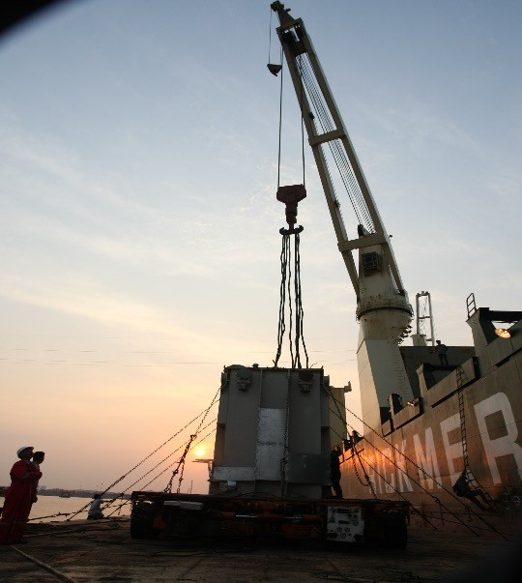
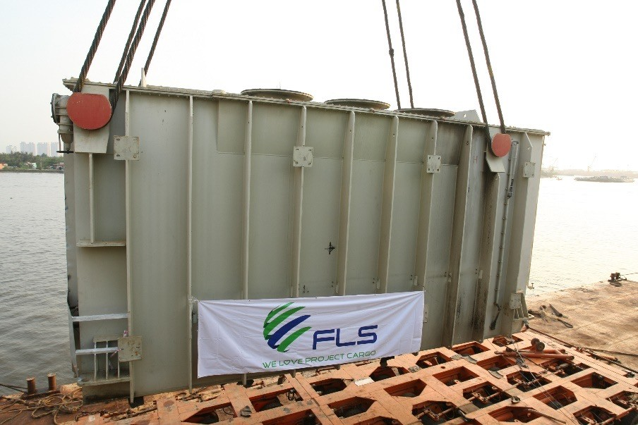


PROJECT REFERENCES
PROJECT REFERENCES
CASE STUDY – 1x TRANSFORMER EA 74 TONS
Volume: 9.50 x 3.20 x 4.65 M, 74 MT
Commodity: Transformer
Origin: Phu My / HCMC
Destination: Qingdao
Scope:
Order from Phu My 3 BOT Co. Ltd to transport a broken transformer from Phu My site foundation to Quingdao port for a repairing job at Siemens China workshop.
FLS arranged pre-carriage ex site foundation and barging alongside ocean vessel.
As well as part chartered a heavy lift vessel shipping the 202MT Trafo from HCMC port to Quingdao port
Return transport including vessel chartering back to Vietnam had been arranged by FLS as well.
27

Slide 28




PROJECT REFERENCES
PROJECT REFERENCES
CASE STUDY – 350MT DOMESTIC TRANSPORT AND JACKING
Volume: 350 MT heavy, 1 package
Commodity: Transformer
Origin: China
Scope:
Transportation from factory to job site for Toshiba
Jacking and skidding from trailer onto trafo foundation
Jacking down onto foundation including alignment under the supervision by a FLS Project Manager
28

Slide 29





PROJECT REFERENCES
PROJECT REFERENCES
CASE STUDY – 354m3 , 173 tONS pre-carriage and port handling
Volume: 354 m3 ,173tons heavy 1x145tons
25 packages
Commodity: 25 transformers
Origin: Shanghai port, China
Destination: Hai Phong, VietNam
Scope:
Pre-carriage from Changzhu factory and pre-carriage to Shanghai port
Port handling and discharge to FAS
Pre-carriage and port handling incl appropriate cargo stow arrangements. Cargo hold preparation for loading by FLS own stevedores
Discharge and load under supervision by FLS supervisor
29

Slide 30







PROJECT REFERENCES
PROJECT REFERENCES
CASE STUDY – TIRATHAI PUBLIC COMPANY LIMITED
Volume: Each between 18 – 25 MT
Commodity: 25 transformers
Origin: Trucking from Tirathai Public Company Limited
located in Bang Poo Industrial Estate
Destination: Natureworks site at Nakornsawan
Scope:
Lashing securing on flat racks and lowbeds
Transport on lowbed trailer
Offloading from flat racks via mobile crane
Position to place of rest / offloading and positioning in the power house
Reading shock recorders
Site supervision with our experienced FLS Project Manager
30

Slide 31






PROJECT REFERENCES
PROJECT REFERENCES
CASE STUDY – BATU HIJAU CCPP-1 PROJECT
Project Name: BATU HIJAU CCPP-1 PROJECT
Commodity: GAS TURBINE GENERATOR SYSTEM
Volume: EX NRK: 73 PKGS / 327,640.00 KGS / 1,447.836 CBM (Heaviest: 90MT)
EX HAM: 80 PKGS / 370,092.76 KGS / 1,560.838 CBM (Heaviest: 86MT)
EX HAY: 26 PKGS / 81,746.00 KGS / 1,139.633 CB
Destination: Benete Bay
Scope:
Loading from Ex Norrkoping, Hamburg & Haydarpasa and discharge at Benete Bay
31

Slide 32




PROJECT REFERENCES
PROJECT REFERENCES
CASE STUDY – Saha cogen & egco cogen
Project Name: SAHA COGEN & EGCO COGEN
Volume: Approx 5,700 CBM
Commodity: Gas Turbine, Generator and Accessories
Origin: Mersin, Hamburg, Norrkoping
Destination: Laem Chabang, Thailand
Scope:
Booking vessel according to client’s requirement
Coordinating with shippers at origins for delivery cargo alongside
Coordinate with vessel agents and vessel owner, port Captain for proper loading / lashing method as per client’s instruction
Loading survey at Origins and Discharging supervision at destination
32

Slide 33




PROJECT REFERENCES
PROJECT REFERENCES
CASE STUDY – 53’ INTERMODAL BOXES CHINA to us West Coast
Volume: 805 x 53’ boxes
Origin: Qingdao and Humen, China
Port of Discharge: Long Beach, USA
Full charter of suitable vessels within a very tight schedule – within the budget
Engineering calculation for Lashing-securing
Loading and discharging
Lashing and securing on board
Customs clearance
Special COVID 19 action plan incl. disinfection required during critical time in China (end of 2021)
Scope:
33

Slide 34
office.vn@fls-group.com
+84 828 73 002 864
34

