Slide 1

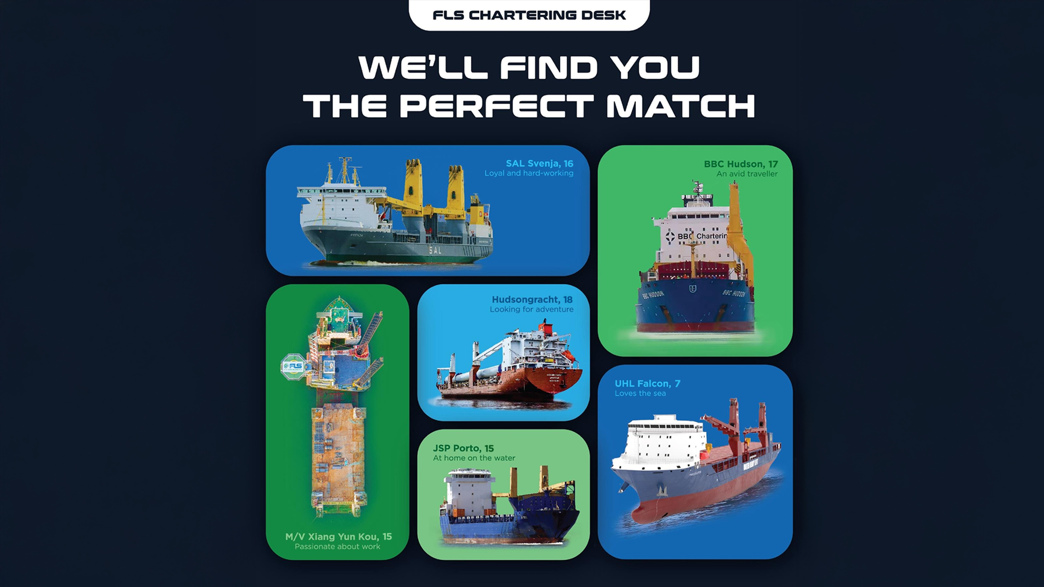
WE’LL FIND YOU
THE PERFECT MATCH

Slide 2
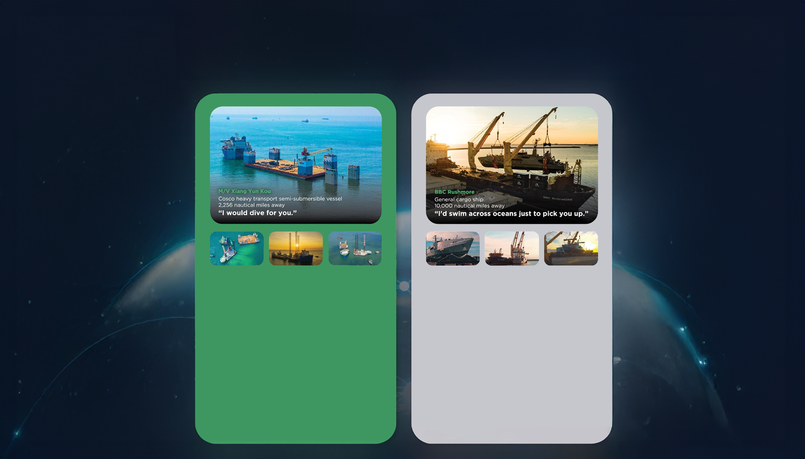
THE RIGHT VESSEL AT THE
RIGHT PRICE AT THE RIGHT TIME
• Half swimmer, half diver
• The big lady of the sea
• Nothing is too big to handle
• Matched with: a 7.000 tonne-floatina drudock and a 6.000-tonne liftboat.
Our buying power and creative solution of combining two shipments allowed us to lock in thebest pricing and the fastest shipping time, despite an extremelv short notice period.
The float-on, float-off loading operation went smoothly and the threesome enioyed a safe journey from Vietnam to Malavsia and the Philippines.
• Any port. Any cargo.
• Accommodating and spacious
• Sailing under the name of the global market
leader of ocean
• Matched with: Austal-built coast guard vessels
As these state-of-the-art vessels are crucial assets for the Trinidad and Tobago coast guard, a best-in-class, door-to-door delivery solution was needed. After securing the reputable BBC Rushmore for these vessels.
FLS experts designed special shipping cradles to support and protect the mono aluminum hulls during the lifting operation and arranged professional divers for a precise loading operation

Slide 3
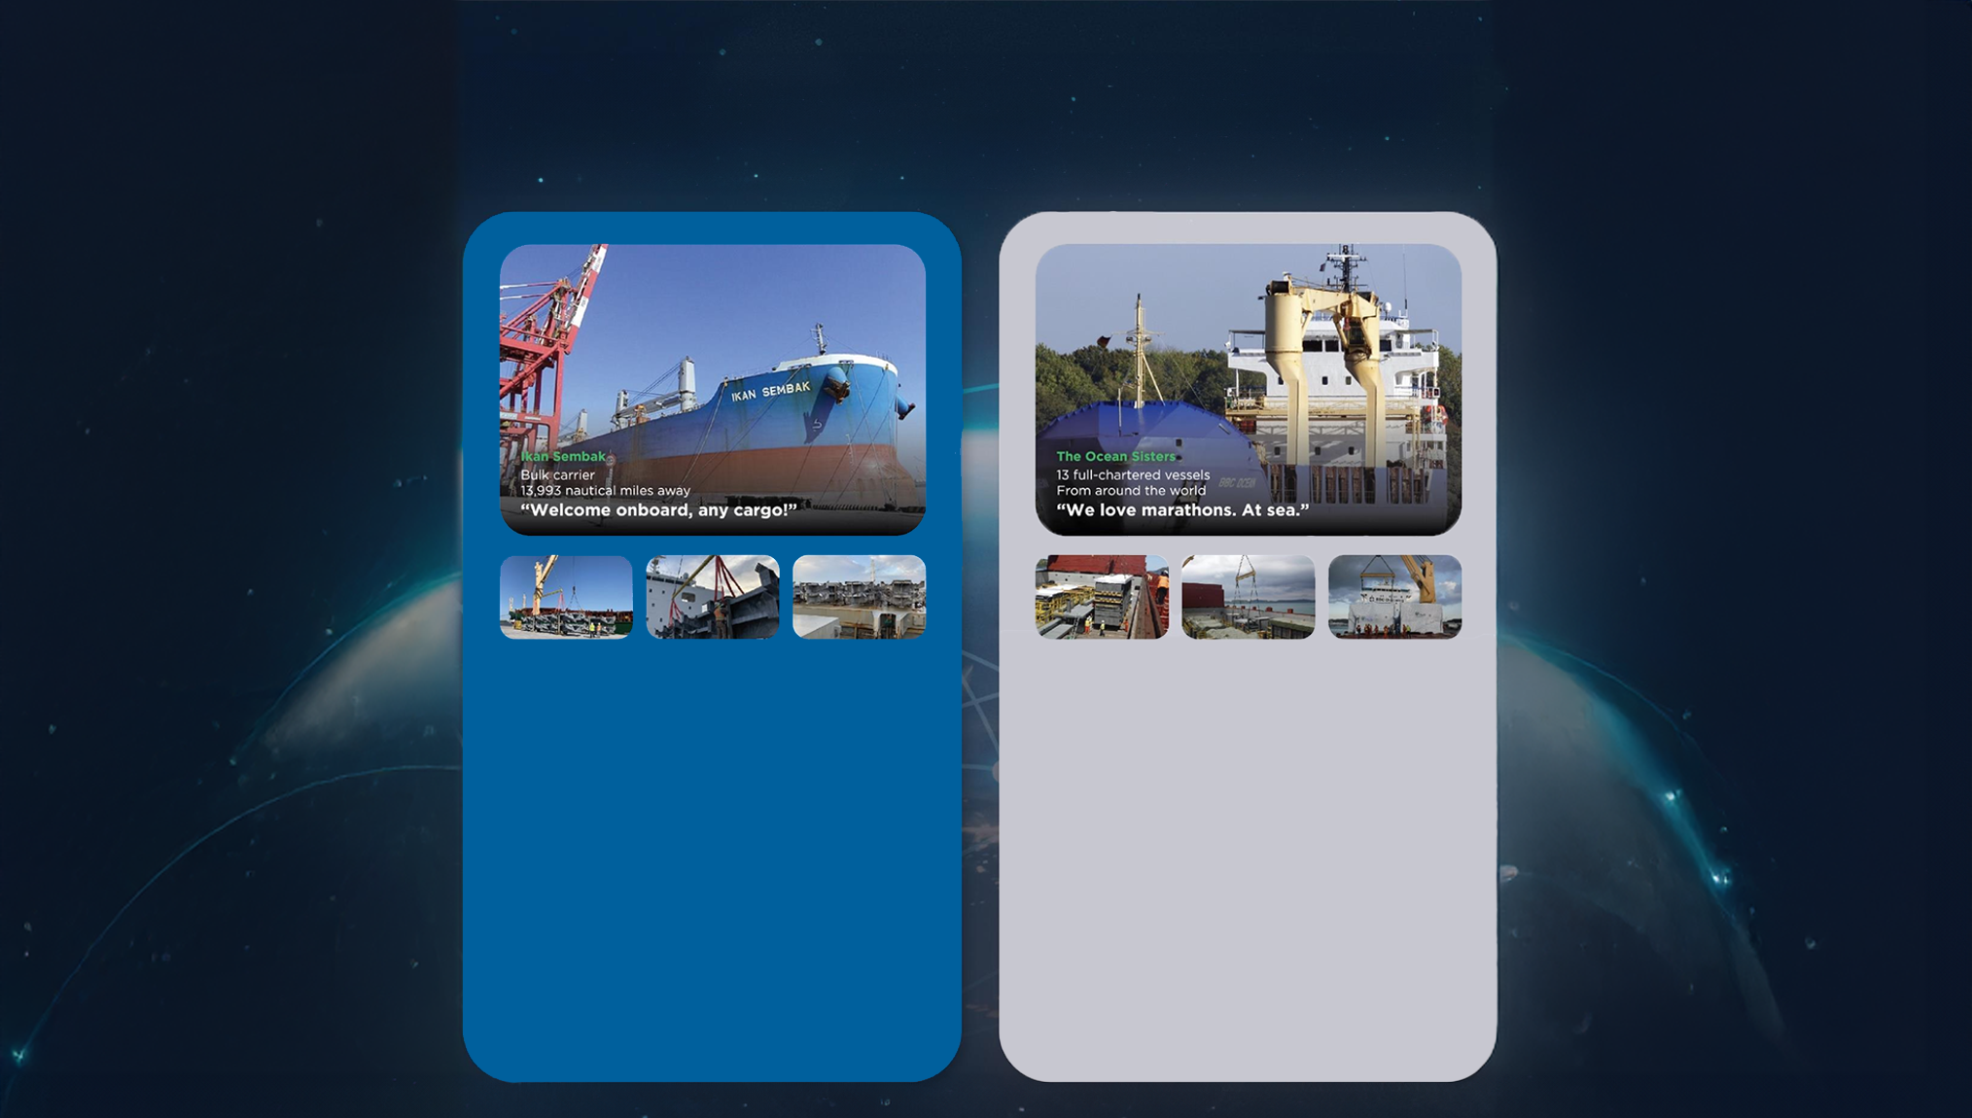
At FLS Chartering Desk we pride ourselves on having long-standing relationships with vessel owners all around the world. This means we can find the perfect match for your needs, while also trying to fulfill your budget and time requirements.
Below are just a few of the perfect matches we've made for our customers.
• Born in Japan
• Enjoying fantastic voyages for the last decade
• Making friends across the globe
• Matched with: Niles, Guernsey and Jackson
combined-cvcle power plants.
Six successful voyages matched so far! FLS
provided packaging guidance and improvement, with customised metal frames to protect the stability of the heavy cargos and our in house stevedores assisted various lifting and lashing operations.
We successfullv saved costs and reduced transit time for two clients in this consolidated shipment.
• We go where cargos love to be
• Devoted to you
• Teamwork is dreamwork
• Matched with: 164 modules, around 225.000
FRT of equipment for a petrochemical plant
in Houston, USA.
A complicated multimodal project which took us 1,5 years to complete. As well as 13 full-chartered vessels, we also provided bespoke trucking, wrapping, stowage and barging solutions.
Our good relationship with carriers and local authorities helped the cargo enjoy a comfortable journey.

Slide 4

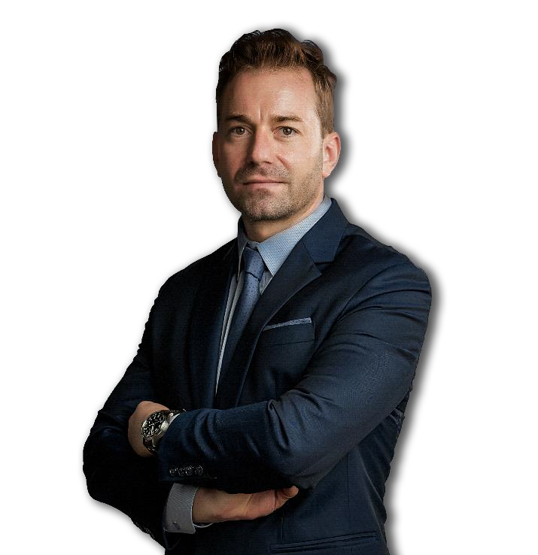
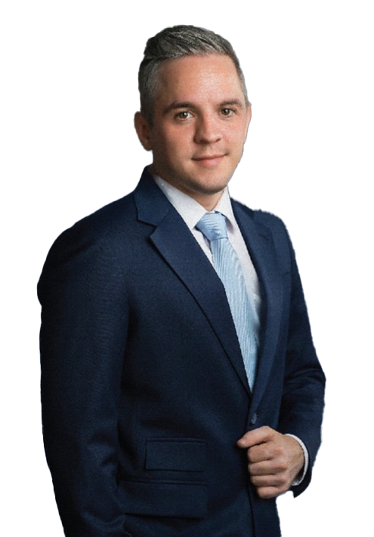
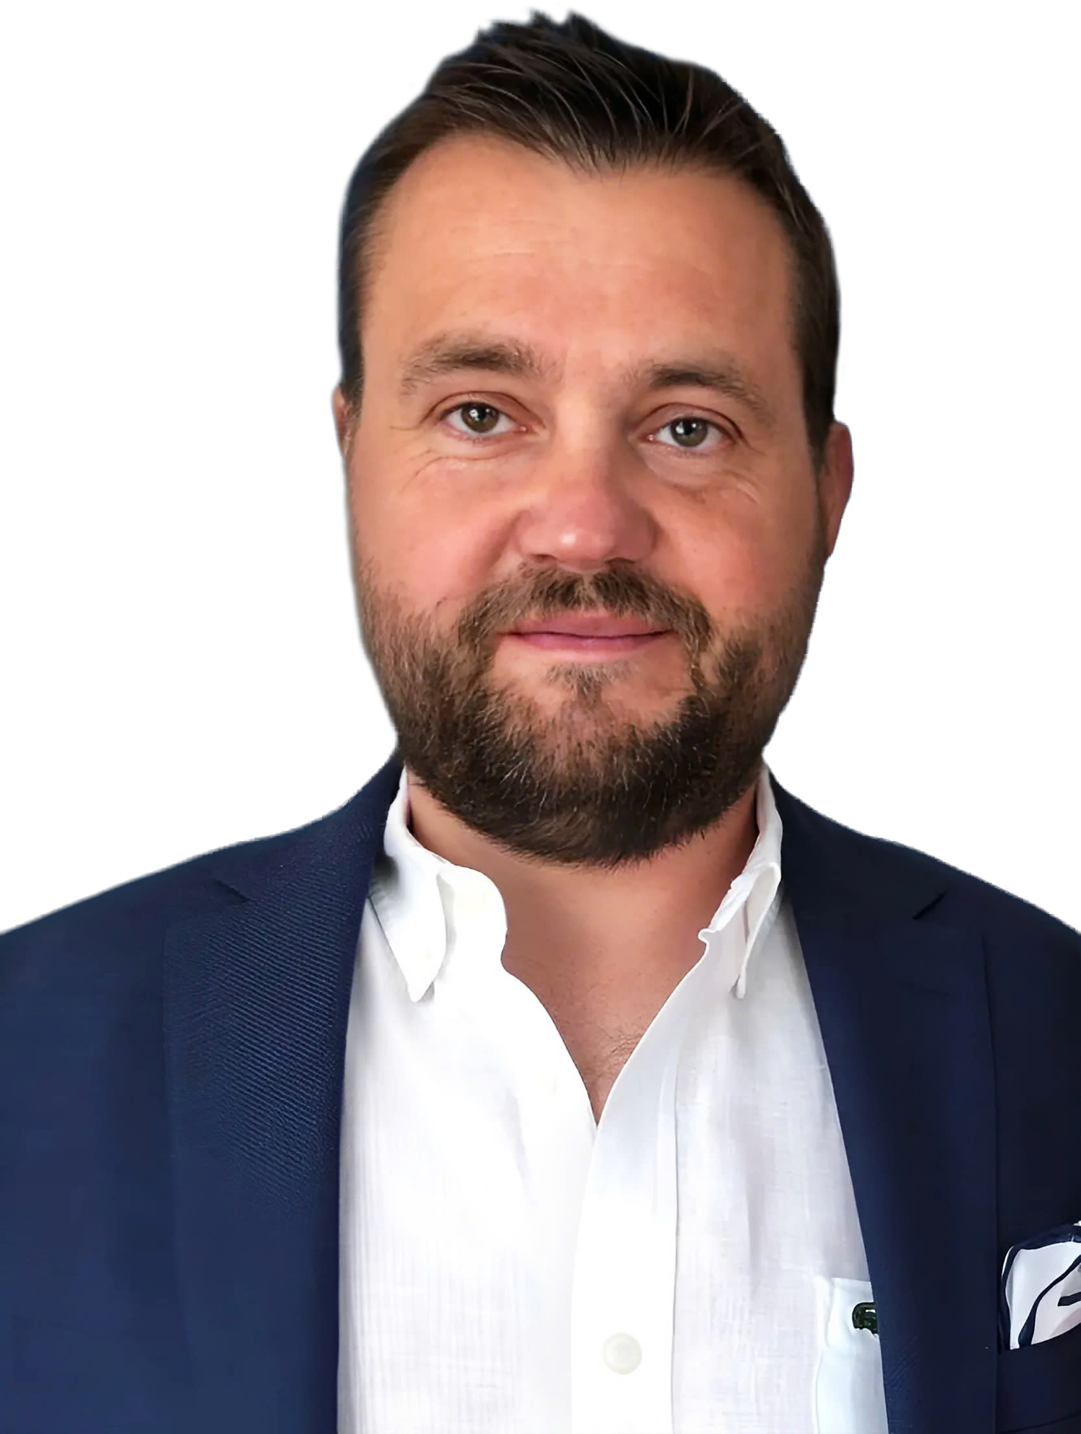
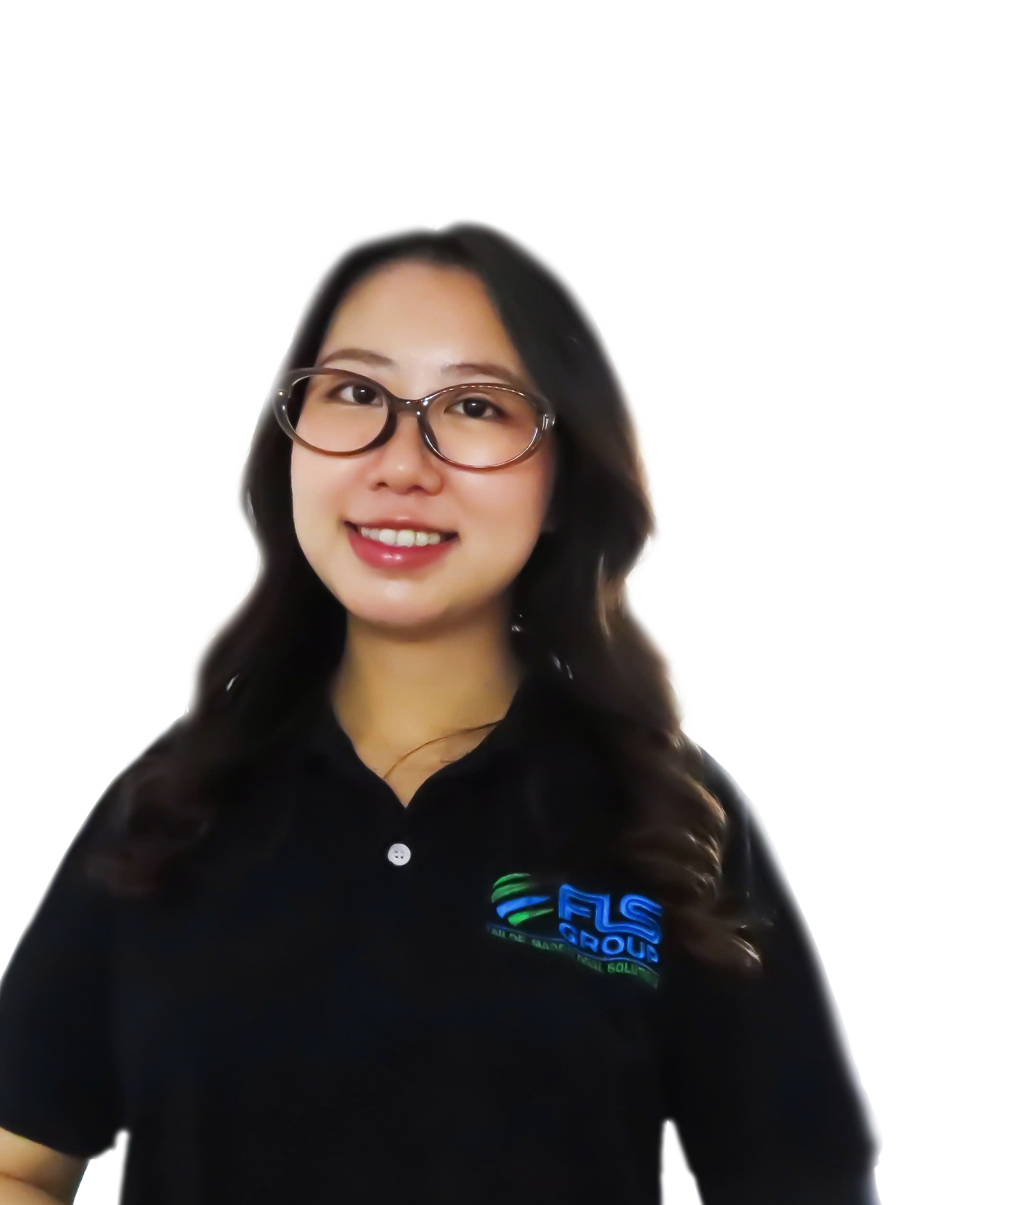
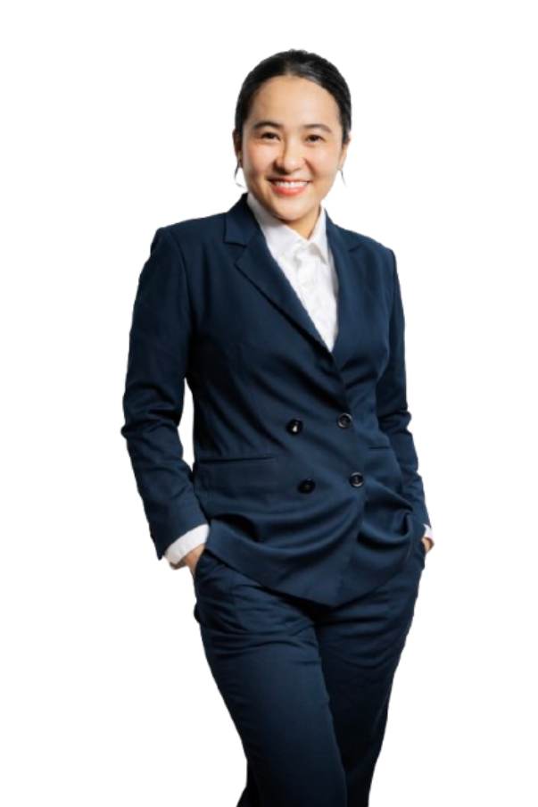
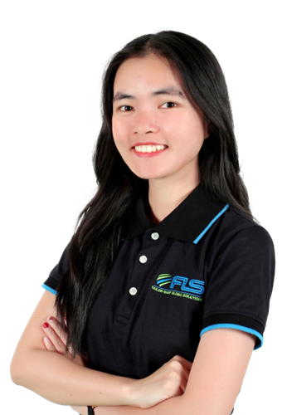
GLOBAL VESSEL ACCESS. PRECISION OPTIMIZATION
FLS Chartering Desk provides direct access to a global network of vessel owners, enabling unrestricted selection across the market. Leveraging strong buying power and deep market understanding, we optimise every charter for cost, timing and operational performance.
SVEN
HOEHLE
HEAD OF GLOBAL PROJECT SOLUTIONS
CHARTERING DESK
CHRISTOPHER SCHNIEDERS
GLOBAL DIRECTOR PROJECTS
SUNE
THORLEIFSSON
MANAGING PARTNER | CHARTERING
VI
NGUYEN
CHARTERING
MANAGER
KHUONG
NGUYEN
PROJECTS SOLUTION
EXECUTIVE
LINH
NGUYEN
CHARTERING
EXECUTIVE

Slide 5
Benefits of taking over the ocean freight scope
1 | Increase scope for forwarder and therefore your leverage to achieve better commercial results for the entire project. Avoid mark-ups by origin.
2 | Get better control over supply chain by dealing with suppliers directly. Transport plan will be tailor-made to your needs.
3 | Get unfiltered first-hand information in order to make quick and qualified decisions (in case of delays in production, on the job-site etc.). Greater visibility into supply chain.
4 | Better risk and compliance management. Direct oversight ensures that all transport activities comply with regulations, reducing the risk of legal issues. You can implement specific measures to safeguard against potential risks such as damages, theft or loss.

Slide 6
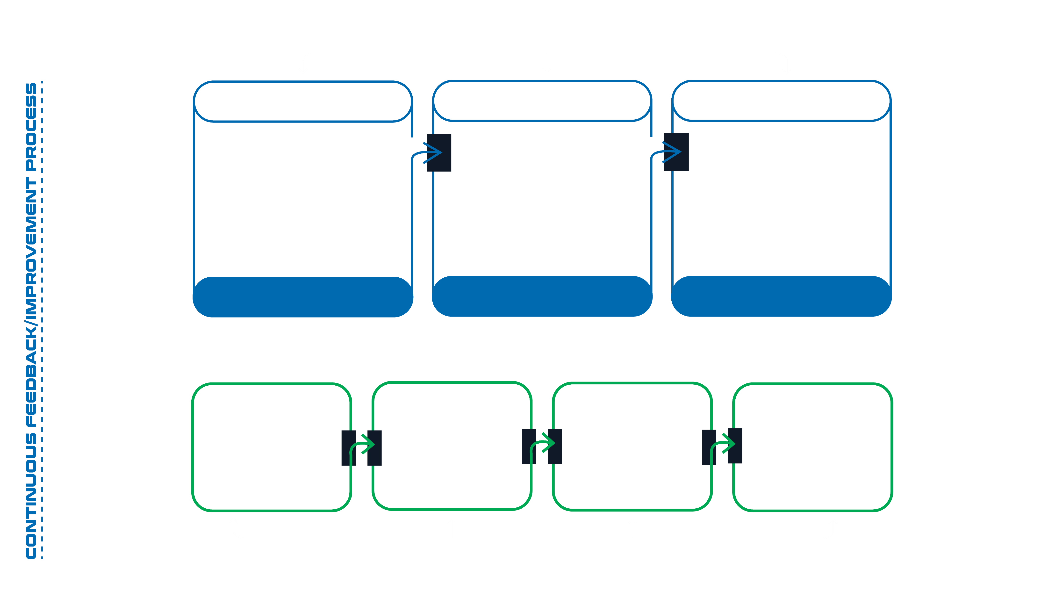






COMMERCIAL PROCESS
Customer interaction/feedback/information exchange at any required stage in the commecial process
BOOKING/FIXTURE
VOYAGE MANAGEMENT
DOCUMENTATION
Inquiry
Vessel Nomination
Cargo Documents
Vessel and Stow Planning
Requirements Definition
Equipment Management
Quoting/Negotiation
Loading Execution
Voyage Execution
Invoicing
Process
B/L
Process
Cargo Fixture/Recap
Discharge Execution
Voyage Review
Chartering Process
Vessel Operations
Processes
Document Handling
Processes
Technical/Cargo
Operations Processes
HSEQ Processes
Customber
Debriefing
METHOD
STATEMENTS
RISK ASSESSMENT
DETAILED
TRANSPORT
ENGINEERING
TECHNICAL
FEASIBILITY
EXECUTION
MANAGEMENT
TECHNICAL PROCESS
Customer interaction/feedback/information exchange at any required stage in the commecial process
6

Slide 7












FLS VITAL STATISTIC
33+
700+
100+
14
$65 MILLION
years of experience
professionals
global partners
countries
is the largest single contract award
ANNUALLY
40,000+
20,000+
$250 MILLION
trucks moved
shipments delivered
consolidated revenue
MORE THAN PERFECT MATCHES
We'll assist you with expert advice and tailor-made services, from start to finish.
Voyage Planning: Deciding if single or multiple voyages are required, according to your unique requirements
Vessel Operations: Bunkering, supplies, crewing when required; insurance, port terminals, ports agents, from on hire to redelivery/off-hire of vessel
Quality and HSSE Compliance Oversight
Pre-Planning well in advance of any request
for offers
Load, Stowage and Discharge Operations:
Lifting, stowage and securing plans including
technical calculations and technical drawings;
required lifting/rigging/securing equipment.
cradles, grilling, cribbage, etc.
Other On-Shore Operations: Trucking, crane rental, ports agents, customs entry for vessels, etc.
Providing Port Captains, Supercargoes,
Marine Surveyors and Supervision of lift,
load, stow, secure and discharge activities
And anv requested services to ensure vour shioments and alobal supplv chains
run efficientlv, smoothlv and on time.

Slide 8
THANK YOU
FIND YOUR PERFECT MATCH NOW!
Let us secure the right vessel for your next cargo,
FLS CHARTERING DESK - Part of FLS Group
fIs-group.com
SVEN HOEHLE
Head of Global Project Solutions
Tel: (+84) 909 277 688
Email: sven.hoehle@fls-group.com

